Slide 1
Introduction to data-driven AI applications and multi-modal search
Notes:
Welcome to the session on Data driven AI applications and multimodal search we have a packed agenda with some cool demos , practise labs and more importantly I am going to talk the fundamental concepts which help build multi-modal powered by AI , search app. We are going to dive into building retail e-commerce store and will see how AI’s role in a search feature. By the end of the session you will be building a e-commerce retail store with AI backend .
How many build AI apps so far ? Apps using AI models? Raise hands
Apps using RAG/Vectors and embeddings?
So the target audience for this presentation
is anyone who's kind of familiar with AI but not in the Deep technical details in
terms of like how to use in vectors and embeddings and um how to work with
different prompts
***************************************************************************************************
I'm going to be showing you a demo that I've been put together uh which is like
AI applications and multimodal search I'm going to be showing you a demo that I've been put together uh which is like
a store that's got some AI in the back end and I'm going to explain um how AI
can serve a role in like a search capability for a traditional e-commerce store but like this same rule idea kind
of applies in any kind of app
So the target audience for this uh presentation
is anyone who's kind of familiar with AI but not in the Deep technical details in
terms of like how to use in vectors and embeddings and um how to work with
different prompts and stuff like that so so before we kind of get started I just want to set a distinction between

Slide 2
Agenda
Do you need an AI?
Introductions
Prerequisites for this tutorial
Demo application
AI is not just LLMs and GPT
Types of AI
Completions, embeddings and other LLM concepts
Multi-modal embeddings
Storing embeddings
Vector Search
Building AI applications in Python
(Hands on work)
Considerations for Production
Manual Experimentation
Automated Evaluation
Monitoring
Wrap Up
Notes:
Today’s Agenda:
First things first we’ll go through the demo pre-requisites give up heads up on things needed for the lab, I really like “Begin with end in mind’ we take a look at final e-commerce app that we are going to build today , get familiar with it , explore features .
Then I ‘ll spend time talking about LLM concepts – RAG, embeddings, vector search , we’ll break into the lab session building the app.
Once we build the app , I’ll talk about some best practices, considerations for hosting your AI apps in prod

Slide 3

About your Speaker
Ramya Oruganti Principal Product Manager at Microsoft
Specializing in Azure Functions, containers and serverless technologies.
Active Contributor to open-source projects such as KEDA, Dapr and Functions in AKS (Azure Kubernetes Service).
Speaker at numerous developer, data & AI industry conferences and forums.
More than a decade experience in product management delivering impactful solutions that meet the evolving needs of customers and business.

Slide 4


Prerequisites for this workshop
Today, you will need:
Python 3.11(Required)
Github account (Required)
Docker Desktop
An editor – Vscode with DevContainer Extension
AI Chat Playground
Azure subscription (Good to have)
Min 4CPU and 8 GB RAM (Required)
An intermediate knowledge of Python, we will be using the following concepts:
Functions, classes and variables
Async functions
Dictionaries and simple data structures
Testing libraries
Don’t have Python?
Here’s a great tutorial for installing Python:
Notes:
Azure AI Proxy Playground (mango-bush-0a9e12903.5.azurestaticapps.net)
The Dev Containers extension lets you use a Docker container as a full-featured development environment. Whether you deploy to containers or not, containers make a great development environment because you can:
Develop with a consistent, easily reproducible toolchain on the same operating system you deploy to.
Quickly swap between different, separate development environments and safely make updates without worrying about impacting your local machine.
Make it easy for new team members / contributors to get up and running in a consistent development environment.
Try out new technologies or clone a copy of a code base without impacting your local setup.
The extension starts (or attaches to) a development container running a well defined tool and runtime stack. Workspace files can be mounted into the container from the local file system, or copied or cloned into it once the container is running. Extensions are installed and run inside the container where they have full access to the tools, platform, and file system.
You then work with VS Code as if everything were running locally on your machine, except now they are separated inside a container.

Slide 5

Structure of the workshop
Where possible, we will include QR codes to any links – keep your phone handy!
Miss something? Don’t worry. The slides and the source code for this workshop will all be available online for the next 6 months.
https://aka.ms/pyconaiworkshop

Slide 6
Demo
Notes:
Switch to demo showing the finished application from this workshop. <<Include QR code of the demo>>
Prompts - スカーフ (scarf in Japanese)
and I'm going to show you now
this app here's a QR code for the source code for this demo if you want have a look I've tried to keep this the code
for this as simple as possible because there's only there's really kind of two techniques I want to show you with AI in
this um in this demo it is a python demo um but uh you could apply the same
techniques to any other language or any other framework so I'm going to switch okay
so I've set
up a really really simple uh like e-store so I've got homepage uh I actually made
this uh in with GitHub co-pilot um so I'm not a very good UI developer I'm a
backend developer I work in Python um so I asked it to create a Tailwind CSS page
for me and I created just this homepage with some fictional products inside it so I've got a database uh with some
products and again even those products actually I asked the uh the AI to make for me
so in um in co-pilot chat in
Visual Studio code uh I said can you create some fake data for me um like the
things I want is a name a description and a price like those were the things I
wanted so I wanted to create a store um with some products in it some clothes uh
and I've created this with a really simple database with like a t-shirt um
uh some hoodies uh like a dress and for one of the sort of fake products that
the AI came up with I copied the description so like it came up with a description for the Azure Dream t-shirt
and I copied that description and put it into Bing create and then said can you
create a photo realistic image of a product that kind of matches this description so that's how I can It
produced that for the Azure Dream t-shirt like this is what it came up with um that's like azure blue that
color so I use this basically to create a uh store with just 16 products and
each one so we've got like a the red hoodie we've got some green shorts a blue jacket um just some really kind of
basic products um that we can have and each one in my database has got a
description so I've got a description of what this is um and this is kind of what
you typically have for for something like a store so we've got you know a hoodie here um it describes it in plain
English and the user can go in my store and they can type in a search for uh
hoodie so they can look for hoodie uh and that will come back and give them uh
hoodie that's like the first answer it comes back with now that's not very impressive that's technology that's
existed for 24 years um now where AI can
kind of come into this is um like users are not always really specific about
what they're looking for or in order for a store like an e-commerce store to have a really effective search someone on the
back end needs to provide like a lot of metadata so like what color is this what
type of clothing is it like um like is this for men is this for women is this a
unisex hoodie like um is this for cold weather is this for warm weather like
you'd have to provide all these different bits of metadata in the database and especially if a store was
like bricks and mortar store and they already had all these products you know sitting around in the shop and they
wanted to turn it into an online store someone's got the arduous task of sitting there typing in all that
information so what I wanted to do with this first part is to um say Okay um
like what could I wear something to wear on a cold day and that like is not a typical like
thing that you could just look up in a in a database right because um it
doesn't say something to wear in a cold day in the database um but what we can do with AI
is we can kind of try and work out the sentiment or the meaning of what the user has searched for and match that as
closely as possible with things in our database and we do that using vectors
and similarity and that was one of the models that we uh that we looked at before I'm going to explain that in
detail like how that works but it's come back to me with um a crimson night hoodie and that's probably because I've
said in the description that's a warm hoodie so it's come back with a blue jacket perfect for windy and rainy days
which is when it tends to be quite cold and it's come back with a scarf as well so those are actually pretty good
suggestions um and it's also come back and said like that's what it's searching
for is cold day I'll show you why in a minute and then the other feature that I implemented using AI was um I've got
some images like pictures and what I wanted to have in this app in this
website was the user could take a photo that they've seen in like a magazine or something um of like an outfit or some
clothing and they want to find what do you have that's like this and so so I've
got two pictures I want to use for testing uh one is this one here which is uh a man wearing like a green and yellow
sort of like PL shirt um and some jeans and some shoes so I've only got 16
products in my database I probably don't have anything that exactly matches that but we can have a look to see like
what's the closest and so if I say match outfit uh the AI is going to do a
different type of search um but it's going to search the database and it's going to come back with the closest
things that it can find to what that person was wearing which is a green and
yellow flannel shirt it is a slightly different pattern but it's pretty it's pretty close um I don't have a pattern
that exactly matches that particular type of PL and it's come back with a pair of jeans those are black jeans um
this man is wearing blue jeans but uh I didn't have blue jeans in my database so that's what it's come back with um as a
pretty good guess like that's a pretty solid kind of recommendation to the user so the idea was that um the AI
could provide a capability that would be really difficult for for us to kind of write um and figure out or the user
would have to sit there and type in oh do you have anything that's like a shirt and then you know they'd have to describe it for you and then the other
test image I've got is this one here uh which is a woman with a denim jacket and like a green backpack it's a side
profile as well so this is actually quite difficult to work with um and you know there's a blue background and a
pink background so I can drop that one into the search and do a match uh and see what it comes up
with and it's going to come back with uh a green backpack you know it's not the
same one but again like that I don't have that particular backpack in my shop I don't know where it comes from but
that's the closest thing we have to what you were looking for like it's an olive green backpack it has a leather buckle
on it instead of a this one doesn't have any Buckle um and there's a denim jacket like this is a slightly darker blue but
it's a pretty good fit um and it's a pretty good estimate so if we did have a lighter blue denim jacket in our store
it would come back with that uh as the as the recommendation
so I'm going to explain to you like how that works and
one thing I want you to keep in mind is so far I've shown you two AI Integrations and there is no chat
feature I haven't put a chat window on the side there's no bot on the side where you have to type in what you want
this just feels like and looks like an e-commerce store but we've actually used
um the GPT model in the background we've used the embeddings model and we've used the computer vision model so we've used
three AI models in this capability but as far as the user concerned they're not interacting with
the chatbot they are just looking for clothing on a clothing store and they're typing in a search and people know how
to do that they've been doing that since like the late 90s people have been interacting with online stores they know
how to do searches they can often be quite vague um but this match outfit kind of thing is a a new feature I guess
+++++++++++++++++++++++++++++++++++++++++++++++++++++++++++++

Slide 7

Machine Learning vs. Artificial Intelligence
Machine Learning
Artificial Intelligence
ML is a specific type of AI that uses statistical learning algorithms to enable machines to learn from data.
Common types of Machine Learning include:
Statistical Modelling
Classification
Natural Language Processing
AI systems can perform complex tasks, such as “understanding” natural language, recognizing faces or emotions, and making recommendations.
Large Language Models are a form of Artificial Intelligence
AI can involve ML and other techniques to achieve a range of capabilities such as perception, reasoning and natural language processing.
AI and ML are not mutually exclusive.
ML is often used to train AI models to perform a specific task
Notes:
I just want to set a distinction between
machine learning which we've been doing for a long time and artificial
intelligence because these two terms kind of get chucked in together nowadays and people talk about AI when they're
kind of really talking about machine learning or spotting patterns or regressions and things like that so
machine learning is a type of AI that uses mostly statistics and algorithms to
calculate or predict information , we can use that for things like modeling ,
we can use it for things like classifications so identifying like um
types of information or machine learning is often used for like images and looking at patterns and images for
medical studies or it's used for looking at natural language and understanding text or we use it for statistical
modeling uh for things like analyzing the stock market or looking at um like
puts of machines and stuff like that it is highly sort of mathematical based and
uh it's based on algorithms which have been tried and tested for for decades and developed this is a an interesting
field .
AI on the other hand can kind of perform slightly more complex tasks
such as understanding which I've put in quotes because it's debatable whether the AI really understand something but
it can understand natural language it can do things like recognizing face or emotions and making recommendations so
it's kind of like the bridge between the algorithms and like the interface that us the user.
large language models uh are
now kind of one of the huge talking topics over the last couple of years which is llms and gpts and how that
serves a role in AI um they are a for of AI they're not the only Ai .
AI can involve machine
learning and actually mostly does use machine learning algorithms to actually deliver the capabilities such as
perception reasoning and natural language processing so machine learning and AI we kind of talk about ML and AI
uh as being two different kind of fields or different areas um but they're not
mutually exclusive like machine learning is often used to train AI models and if you look at how AI works and machine
learning is at the core of it .
This slide is a comparison between Machine Learning and Artificial Intelligence, two terms often used interchangeably. While they share some similarities, they describe different concepts and have distinct applications. Machine Learning is a subset of AI, and refers to a computer's ability to learn from data without being explicitly programmed. In contrast, AI refers to the simulation of human-like intelligence in machines that are programmed to think and learn like humans. This slide was created for a technical audience and uses technical terms to describe the differences between these two technologies.

Slide 8
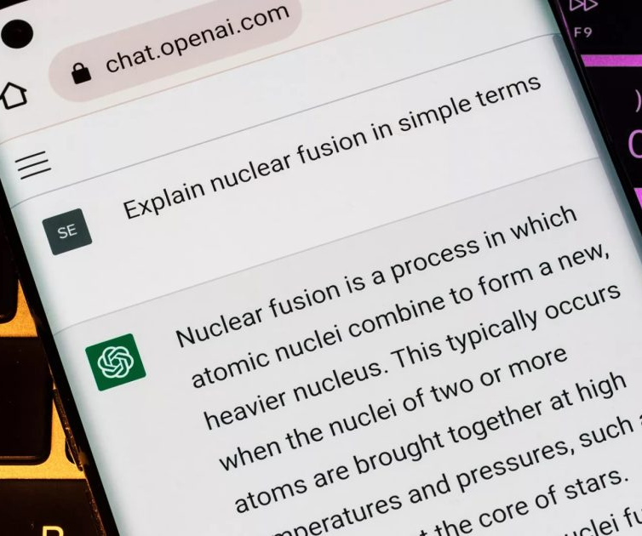
AI != ChatGPT
Logging + Authentication
Web UI
Tokenizer
System Prompt
Chat Completions Model
Model
Notes:
This diagram shows that ChatGPT is a complete application that uses Chat Completions Models with a set of other components.
so I just want to kind of set that distinction first before we jump into
um some more some more details so um another thing I mean uh actually
actually giving a talk this week at a high school and I asked the students
they're in the eighth grade so this is 13 14 year olds how many of you use chat
GPT and I think almost every single one put their hand up um the technology is
prolific um I think that when people look at AI now they think about these
kind of chat Bots and llms especially consumers so you know I've been developing for uh quite a long time now
but been working with uh AI or what was Ai and machine learning for a couple of
decades and um llms are not the only form of AI but now when I talk to users
or consumers and I talk to them about AI they are now starting to think about these chat interfaces like chat GPT or
co-pilot and chat GPT is not just the
model it's an application built on top of that so you know you have to log into it it has a web interface it has
something called a tokenizer which takes the text from the user and then feeds it into the model and then it also has a
system prompt so chat GPT has a quite a large prompt that tells the chat model
how to behave as chat GPT we have a different prompt for uh co-pilot word
for example or co-pilot in Outlook co-pilot in SharePoint so any of those other co-pilots have they are basically
different applications all built on the same core technology um but they have different prompts and they are different
applications so I do want to set that distinction because um often people are
kind of bundling just the topic of AI with chat apps and that's not really the
whole the whole story

Slide 9
OpenAI Models
O1-preview
MODEL | DESCRIPTION
GPT-4o | GPT for complex, multi-step tasks
GPT-4o mini | GPT for fast, lightweight tasks
DALL·E | A model that can generate and edit images given a natural language prompt
TTS | A set of models that can convert text into natural sounding spoken audio
Whisper | A model that can convert audio into text
Embeddings | A set of models that can convert text into a numerical form
Moderation | A fine-tuned model that can detect whether text may be sensitive or unsafe
Notes:
um talking about open AI in particular open actually has
a lot of different models and they perform or they can do different things so uh GPT is the one that's used for
chat GPT and there are different versions of the GPT model um often if
you're using Bing chat you can switch or you can choose whether you want to use
gp4 which is one of the newer models the newest one for GPT is GPT
40 and there are two flavors I guess of that model there's one which is for
complex multi-step tasks or where you've given it a lot of text to analyze and respond to or there's the Mini model
which is uh fast and lightweight and we're actually going to be using a bit of GPT 4 and a bit of the Mini model in
the talk today and in the demo I'm going to give you uh there's di which is really fun which you can use to uh
generate create pictures or images based on a prompt uh so if you use Bing create
that's what is being used behind the scenes uh
TTS which uh and Whisper which
is kind of about working with spoken audio and converting that into text and vice versa
we've then got embedding
models and these are really interesting technology and this is actually G to be
one of the focuses of this talk is the embedding models um and I'm explain what
an embedding model is how we work with vectors and how that technology can be used to enrich or improve a search
capability in an application
uh there's also models for moderation uh we use
that to look at whether text could be sensitive or unsafe uh and those models are used for things like copilot and and
chat GPT so uh large language model

Slide 10
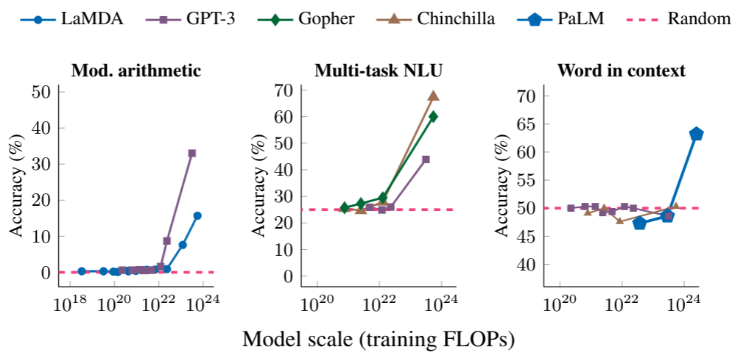
LLM: Large Language Model
An LLM is a model that is so large that it achieves general-purpose language understanding and generation.
Review: This movie sucks.
Sentiment: negative
Review: I love this movie:
Sentiment:
Input
LLM
Output
positive
Notes:
an llm
Goto – [Azure AI Proxy Playground (mango-bush-0a9e12903.5.azurestaticapps.net)] with list of restaurants in bangalore
Large Language Models (LLMs) are a type of artificial intelligence (AI) designed to understand and generate human-like text. They are trained on vast amounts of data, which allows them to perform a wide range of language-related tasks, such as answering questions, summarizing text, translating languages, and even generating creative content.
is a model that's so large uh we talk about the number of parameters it has but that's kind of jumping deep into
science um it is a model so large that that it achieves like a general language
understanding and generation and the way I kind of think about llms is being a model which can
predict the rest of a sentence or the rest of a paragraph and you give it you tell it a story and it will finish that
story for you we call the the parts of the story
The prompts so kind of like
the first prompt would be the instructions to the llm as far as the llm is concerned it's not understanding
a comprehending the instructions it sees that as a story which it has to finish so just as you ask if you ask the
student okay I've written the first three chapters of a book can you write the Final Chapter for me they'd read the
first three C chapters they'd understand who the characters are you know what's happening what's the situation what's
the premise of the book and then they could finish the Final Chapter uh the the quality of the final chapter is
probably going to depend on um the quality of the first three so the better you can make the prompts uh the better
you can have a uh response or a really useful answer from an llm when you're
using something like co-pilot chat or chat GPT um you can't see but there is a
prompt behind the scenes which has kind of set the first part of the story for the llm to fill in and respond to so
we've kind of told the llm before beforehand this is how we want you to respond this is how we want you to
behave this is how we want you to kind of like comprehend what the user has
asked for and then when you get a response back we you know we're hoping that's closest to what you meant and one
of the big challenges with working with language and working with llms is that as humans we can be really really vague
sometimes uh we can say one thing but actually we meant something slightly different if you've ever been in a
situation where you've been texting a friend and they've completely Mis interpreted the tone of what you've said
or what you meant um you know this is a huge challenge especially with text
because so much of what we convey is in body language and tone and voice and
just moving from that to just purely working in text uh is quite a challenge
and so uh we have to provide the llm with a lot of context uh which is called prompts and then um you know it will
kind of vary its responses they're also nondeterministic which means that the
llms will provide a slightly different answer each time because they slightly randomize the sort of sequence of words

Slide 11
Popular LLMs
Model | # of Parameters | Creator | Uses
GPT 3.5 | 175 B | OpenAI | ChatGPT, Copilots, APIs
GPT 4 | Undisclosed | OpenAI
Gemini | Undisclosed | Google | Gemini App
Claude 2,3 | 130 B | Anthropic | APIs
LlaMA | 70 B | Meta | OSS
Mistral-7B, Mixtral | 7 B | Mistral AI | OSS
Phi-3 | 3.8B | Microsoft Research | OSS
Notes:
that they have um some popular llms uh the GPT models uh GPT
3.5 um and GPT 4 there's Google's Gemini models
Claude 2 and three from
anthropic uh
llama from meta
mistol and mixt and 53 or 53.5 I think is now
available as well um so it's not just GPT that's not the only llm out there
there are lots of different uh types of llms and in the AI Studio which I'll kind of give you a glimpse to uh in a
bit you can actually play with an experiment with a different llms

Slide 12
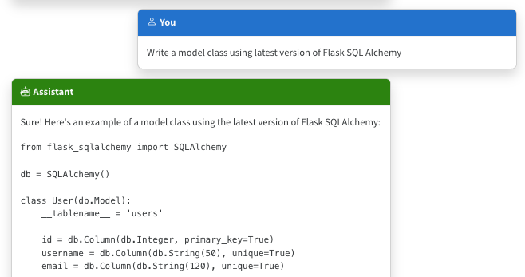
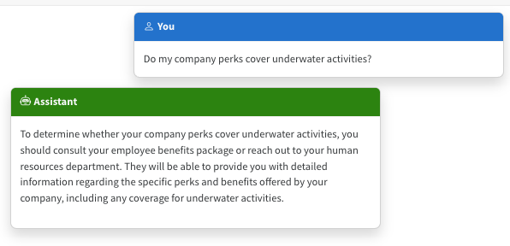
The limitations of LLMs
Outdated public knowledge
No internal knowledge
Notes:
LLMs are basically next-word predictors. They're very good at writing text fluently in many languages, but they're not guaranteed to produce text that is relevant or accurate.
For example, we might ask an LLM to write code for a Python package. It will write code according to what it's seen most in its training data, even if that doesn't reflect the current documentation.
In the example in the screenshot, it produced outdated code based on an older version of the package.
That is an example of public knowledge, and it can potentially be resolved by updating to a newer version of the model.
What about private knowledge? LLMs don't inherently have any access to internal knowledge, like company documents, so they will answer based off what they saw in their training data. And they will still answer confidently, so people can easily be convinced that the answer is correct.
So we need to find a way to bring in internal knowledge or updated public knowledge.
Now you've probably seen lots of demos of LLMS, whether that's the newest GPT model, and they get updated at the moment every six months, and there's some two major challenges.
One is that they only can answer questions on stuff that, since they were trained.
So if you're using a version from six months ago and you asked about something that happened recently, the model was not going to know the answer.
So that's kind of one one thing.
The second thing is only trained on public data and all the GPT models are.
Is not everything on the Internet.
It's actually like a quite limited subset of information.
So like it's knowledge and what it has access to is actually pretty limited.
The training sets that they use for GPT, yes, they are very large, but they don't cover huge swaths of the Internet.
So really, they're quite limited and specific types of capabilities.
Uh, we see this if you use them for coding.
For example, if you're using like a copilot or something, then you find if you're using like a newb library or a new package, or a new SDK, it just doesn't have any experience with that, and so it will try and use the old patterns or the old standards.
So this is like a common limitation with public ellms.
so there are some limitations with
llms as well um they don't have so if you ask it a question um like what's the
weather going to be like today two things one it doesn't know uh it was trained on data from six months ago or
or a year ago depending on which model it is so it doesn't know um and secondly
it's um doesn't have it doesn't know where I am um but like I said earlier if
you it's all about kind of finishing a story with the llm and often if you've
kind of set the first part of the story which is oh you're a really helpful assistant that answers questions and the
the sentence that the user has asked is tell me about the weather then the llm will think that you want it to tell you
about the weather and it knows how to respond to a question about the weather it will just say it's sunny today or
like it's going to rain at 3:00 but it's doing that because it's finishing the story it's not checking the weather
charts it's not speaking to the Bureau of meteorology here in Australia um it is trying to finish a story and that's
why we have to be careful when we work with the prompts to tell the llm as part of the kind of the background story I
guess for the llm is that yes you are a helpful assistant but if there's something that you can't determine
because it's recent or it's you know it needs to be looked up on the Internet don't make it up don't tell the user
it's going to be sunny if you don't know it's going to be sunny so this is a super important fact um and something
that you have to work with uh with llms

Slide 13
Incorporating domain knowledge
Prompt engineering
Fine tuning
Retrieval augmentation
In-context learning
Learn new skills
(permanently)
Learn new facts
(temporarily)
Notes:
How can you incorporate domain knowledge?
RAG enables learning new facts temporarily by doing a retrieval and adding/augmenting the question to the LLM with the data.
So there's three ways that you can add additional knowledge to an LLM.
One is you can engineer the prompt, so when you ask the LLM a question you can include some extra information or you can kind of lead it to towards an answer. Prompt engineering:. Be very very specific. Tell it the version, give it written examples. This only works if the answer is somewhere in it’s weights
The second thing is fine tuning.
So you can basically train, uh, like a bespoke model.So you can teach at a new skill. which is very expensive to do.
Start with a base model and add at least 200 examples and run training again. Fine tuning is expensive both in the training process and in the usage.
It's time consuming and you need a huge amount of data to do it reliably, and so in most cases I've where I've spoken to users who've asked about fine tuning what they really want is retrieval, augmentation, and because the type of problem they have is actually better suited to RAG.
there are three techniques you can
use to kind of improve llm so that they can understand or they can reply about
what we call domain knowledge but that's other information so that could be uh
the good example is always the weather everyone loves that example but um I'm going to show you some stuff which is
slightly different which is more about search and how we can use search capability um but domain knowledge you
can use three things one is prompt engineering uh which is um when you kind
of create the prompt you can give it some extra information in the prompt and and I'll show you how to do that uh we
can do something called fine tuning which is kind of where we take the the base model and we actually retrain it
with some new skills um to do this is quite expensive because you have to use
all the gpus to retrain the model uh and also you have to have a lot of data to do that so you can kind of make your own
uh model or you can build on top of a base model with additional capabilities uh and those are things that we've done
with uh stuff like co-pilot for for example so we've kind of optimized those models for specific tasks uh
and then
the other one which is kind of similar to the first one which is retrieval augmentation um where you find some
information uh the user asks a question you find some information and then you put that in the prompt you include that
in the prompt uh and that's the technique we're going to use in this demo um

Slide 14
Retrieval-augmented generation (RAG)​
Notes:
Let's talk about RAG, Retrieval-Augmented Generation.

Slide 15
Retrieval Augmented Generation (RAG)
User question
Workflow
Retrieve related data
Retriever over Knowledge Base
Augment the prompt
Generate response
Large Language Model
Send Results
Notes:
One of the keys to successful LLM app is context. I want to talk about two approaches to adding context to LLM apps.
You can fine tune: More complex, more upfront expensive, greater skills required
Now the more popular approach is to augment a prompt with addition context using the RAG pattern
At a high level, this is the basic architecture of a RAG application
This slide has builds: User question -> Retrieve over knowledge base. -> Augment the prompt - Generate the response
This is a very idealized example of RAG as it’s like to be way more complex
[customer intent extraction, chat or support, Prompt rewriting, chaining models, safeguards for best output..]

Slide 16
RAG: Retrieval Augmented Generation
For great hiking shoes, consider the TrekExtreme Hiking Shoes¹ or the Trailblaze Steel-Blue Hiking Shoes²
What's the best shoe for hiking?
[101]:
Name: TrekExtreme Hiking Shoes Price: 135.99
Brand: Raptor Elite
Type: Footwear
Description: The Trek Extreme hiking shoes by Raptor Elite are built to ensure any trail.
…
Large Language Model
User
Question
Search
Notes:
<update this slide to be in sync with current demo>
Azure OpenAI + AI Search (app-backend-iwzkudjoxfepe.azurewebsites.net) – Use this to showcase demo
Or show rag.ipynb ➔ Prepare user question
We're focusing on the RAG approach in this session, as it's the most popular and cost-effective of the options.
Let's walk through a simple RAG flow.
First, the user asks a question. We use that question to search a knowledge base, and get back the top results.
We then concatenate the user question with the search results, and send both of those to an LLM, with a system prompt that tells it to answer according to the results.
We get an accurate answer back that includes citations pointing at the results.
So with RAG, if the user asks the question, uh.
Go to this example - Azure OpenAI + AI Search (app-backend-iwzkudjoxfepe.azurewebsites.net)
Use the example of what does northwind health plus offer better than standard
===========================================================================
So, like, what's the best shoe for hiking then?
The retrieval part is basically finding out some extra information from a live data source, and that data source could be like a database for example.
So your system, your code could do a search in a database and it could find let's say some hiking shoes and it gives that information to the large language model along with the original question.-
So basically takes the result from the database and the question copies and paste them together.
It sounds really fancy retrieval augmented generation.
It's basically just a double copy paste and you stick the two things together and then you give it to the Llm and say the user asked this question.
Here's some extra information we found in the database.
can you provide an answer and then the LLM can provide an answer that has a lot more relevance so it says it.
Strings it together makes it sound really fluent and says oh, for great hiking shoes.
I consider you should consider this particular product or this other product and this is in a sense how Bing works now.
So if you use Bing Bing chat and you ask it a question, you'll see one of the first things it does is it does a Bing search.
So it does like a normal search on the Internet to find the information and then it gives that information to the idolm along with your question which is then combined back into a poke answer.

Slide 17




The importance of the search step
Garbage in, garbage out:
If the search results don’t contain a good answer, the LLM will be unable to answer or will answer wrongly.
Noisy input:
If the LLM receives too much information, it may not find the correct answer amidst the noise.
Source: Lost in the Middle: How Language Models Use Long Contexts, Liu et al. arXiv:2307.03172
Accuracy
Number of documents in input context
Notes:
<<show the demo sample with RAG in action>
More inputs are given, the result are vague. Less inputs more accurate
More inputs, more paragraphs less effective the response
Instead ask 5 times
Colors of each model behave the same .. More inputs less accurate

Slide 18


What is the RAG searching?
Database rows
(Structured data)
Documents
(Unstructured data)
PDFs, docx, pptx, md, html, images
You need a way to vectorize & search target columns.
PostgreSQL + pgvector
Cosmos MongoDB
Eventhouse in Microsoft Fabric
Azure SQL + vector search (upcoming)
You need an ingestion process
for extracting, splitting, vectorizing,
and storing document chunks.
Azure AI Search +
Integrated Vectorization
Document Intelligence or
Notes:
As you've seen, we can build RAG on top of many data source types. You just need a way to index and search your data, ideally with a vector search option.
If your goal is to RAG on an existing relational database, then Azure has great options that support vector search, like Azure PostgreSQL, Azure SQL, and Cosmos Mongo DB.
If your goal is to RAG on documents, then Azure AI Search is the best option, as it is really built for this scenario.
We will be focusing on RAG on documents going forward, since it's more complex in many ways.
*******************************
So in that case the the RAG is searching on documents which is unstructured data and we've done it in a way which we told the first query to the LLM to produce a search query or like a phrase to look for in the database.
Anthony Shaw 12 minutes 42 secondsYou can also ask it to like prepare questions in the form of SQL statements and then you can do searches that way.

Slide 19
Components of a high-quality RAG
1
2
3
Sophisticated LLM
Adheres to instructions
Supports function calling
Well prepared data
Reasonably sized text
Meaningful vectors
Powerful search functionality
Vector search
Hybrid search
Semantic re-ranking
Filtering
Powerful search functionality
Vector search
Hybrid search
Semantic re-ranking
Filtering
Well prepared data
Reasonably sized text
Meaningful vectors
Sophisticated LLM
Adheres to instructions
Supports function calling
Notes:
When we build a RAG application, there are three main ingredients that affect the quality:
We need powerful search functionality, to be able to search massive data sets. For optimal results, we need hybrid search, a combination of vector search and full text search.
We need well prepared data in our search index. The document chunks should be a reasonable size, not too big, not too small, and the vectors should be high signal, low noise.
We need a frontier level LLM that can adhere to the system prompt, stay on-topic, and ideally support function calling for use in the query rewriting stage.
We're going to dive into these components today, to share everything we've learned about building high quality RAG applications.
***********************************
So to have RAG working effectively because there's thousands of RAG demos out there and the one I'm showing is the most popular one that we have by quite a long way, it's not a lot of users.
it's really popular in different geographies as well because we've done a lot of testing, for example with Japanese uh documents and Japanese text as well as huge amounts of testing in English and some other languages too.
And to get a high quality RAG, the same things you need is the LLM.
Needs to be kind of the the prompt that you give.
It needs to follow the instructions very clearly and we use function calling as a way of preparing the question and also we've trained the prompt in a way that if it doesn't think it can find a reliable answer or if it doesn't really understand the question, it will give back the numbers 0 in that case or it will say it doesn't know.
And this is the kind of a trait that we'll get into later with, with the retrieval step, which is that you can't always find a good answer in the database if the user asks about a product that doesn't exist or something you don't sell or something that's irrelevant or is better for the LLM to come back and say that it can't answer that question rather than.
Hallucinating something or just giving you some information?
That's irrelevant, because you'll find that users actually just get frustrated in that case where they've asked it a sensible question, like you know, what's the best camping tent that you sell?
And IT company doesn't sell camping tents and instead of saying we don't sell camping tents or I can't answer that question, it just starts talking about shoes or skis.
I don't know like that would irritate most people and it doesn't kind of give you a sense that it's well engineered and very intelligent.
It's just kind of a frustrating answer, so the data also needs to be reasonably sized and the vectors need to be meaningful and and you need to focus a lot on the search functionality, which is what we'll spend the majority of this talk on.

Slide 20
Vectors 101
Notes:
First, let's step back and make sure we all understand vector embeddings, since we'll need to use vectors for both indexing and searching.
And before we get there, I'm going to give you a brief overview of vectors and the role the vectors play with retrieval and similarity, because it's a really key component in how LLMS are able to stand.
I guess questions which aren't necessarily specifically the words that are in the data set.

Slide 21
Vector embeddings
An embedding encodes an input as a list of floating-point numbers.
”dog” → [0.017198, -0.007493, -0.057982,…]
Different models output different embeddings, with varying lengths.
Model | Encodes | MTEB Avg. | Vector length
word2vec | words |  | 300
Sbert (Sentence-Transformers) | text (up to ~400 words) |  | 768
OpenAI text-embedding-ada-002 | text (up to 8191 tokens) | 61.0% | 1536
OpenAI text-embedding-3-small | text (up to 8191 tokens) | 62.3% | 512, 1536
OpenAI text-embedding-3-large | text (up to 8191 tokens) | 64.6% | 256, 1024, 3072
Azure Computer Vision | image or text |  | 1024
💻 Demo: Compute a vector with OpenAI model
Notes:
Showcase the vector_embeddings.ipynb notebook with sentence – vector representations
So one of the this kind of two major models with open AI and with with other AIS as well.
And we've got the LLM which we're all familiar with.
We've been, we've been using those for a while.
We've then got another type of model called an embedding model and embedding models that typically used for text and what you can do with an embedding model is you give a piece of text.
It could be a word, it could be a sentence, and it will basically give you back the representation of that information as what we call a uh and of Vector or an embedding.
It’s a sequence of numbers and it basically you can pick two sentences or two words and compare them and it will tell you how similar they are.
Uh, if you one of the analogies like to use is that if you took all your holiday photos from a trip and you arranged them on a table in front of you, you'd put a new put photos from the same day next to each other.
And maybe you've got some like beach photos and you put them on one side of the table.
You're arranging them in terms of like they're similarity, but you've only got 2 dimensions to play with.
You've only got, you know, your table is only two D, so you can arrange them like that.
But the these types of embedding models are much broader, so they're able to do that up to 1536 is like the default with the 82 model.
you encode a piece of text up to around 2000 words and it represent that back as a series of numbers called a vector, and then you can take two sentences or two bits of text and ask it how similar they are.
And there's a reason we do this, and it's because.
Some more notes:
we're going to be using a technology called vectors and uh I wanted to give
you an overview of what vectors are and how they work and then how that could be
applied into the store that we had so uh a vector there's kind of two
terms that are thrown around a vector embedding uh an embedding is something
that takes an input um which is a list of floating Point numbers or like
decimal numbers and they range between minus one and one um I'll explain why
they do and like where they came from um but when you hear the word vectors or vector database really what it is is a
list of numbers and it's I think the easiest thing is to think of those numbers as like coordinates in a in like
a space so just as you were working with like if you were working 2D for example in like a map and you were looking at
coordinates and you were looking at a map of uh the US and you had somebody in
Florida and you had somebody in um like Mississippi and those would be different coordinates and you'd say how similar
are those two places and you could look at that by measuring the distance to them so like how close are they together
uh and that's similar to what we do in vectors which is we have these coordinates or embeddings um and then we
can calculate like how similar they are by how close they are to each other in the in the space um there's different
models for doing that and uh the most popular one has been open AI the
catually named texting bedding ada2 uh which is the third one on my
table um this one has been popular because it is the uh embedding model that's normally used with chat GPT 3.5
and GPT 4 um they open AI announced new models a few months ago texting beding 3
small and texting Bing 3 large the difference between those models and the a model is one they are faster um and
two they are cheaper so um you know it basically does the same thing uh
actually much more effectively so in terms of its performance um those models
are uh faster better and cheaper which is a a win-win win in my mind um so
whenever you're looking at embeddings or you're doing Vector work I strongly recommend you look at the new Texas
embedding 3 models uh the small model in particular um outperforms the old Ada
model um with smaller vectors better performance and about a tenth of the
price
Text-embedding-ada models don’t recommend more than 4000 tokens (text-embedding-ada small/large – execution, accuracy, and cost is more effective)
=============================================================
And before we get there, I'm going to give you a brief overview of vectors and the role the vectors play with retrieval and similarity, because it's a really key component in how LLMS are able to stand.
A vector embedding is a list of numbers, and that list represents a particular input inside a particular embedding space.
There are many embedding models that take different inputs and produce vectors of different lengths.
An older embedding model, word2vec, encodes single words and outputs lists of lengths 300.
The embedding models from OpenAI can take in long strings of text, up to 8191 tokens, and produce vectors of varying length, between 256 and 3072 dimensions.
There are also multimodal models like Azure Computer Vision, that can take inputs of image OR text, and produce vectors with 1024 dimensions.
A good embedding model is a balance of speed and size vs. performance. A vector with 3072 dimensions probably encodes more information than a vector with 256, but you may not need the extra 2500 numbers for your application.
The MTEB (Massive Text Embedding Benchmark) is an open benchmark that evaluates embedding models and summarizes results on a public leaderboard. Consider that benchmark when selecting a model.
Let's quickly embed a vector using an OpenAI embedding model.
// Open notebook, run cells
******Notes/Links***
Word2vec is a NeuralNetwork method. Glove, LSA, are reduction techniques.
MTEB (Massive Text Embedding Benchmark) is an open benchmark.. MTEB includes 56 datasets across 8 tasks and currently summarizes >2000 results on the leaderboard. Uses 112 languages.
https://platform.openai.com/docs/guides/embeddings/use-cases
https://www.reddit.com/r/MachineLearning/comments/13aaj2w/d_is_openai_textembeddingada002_the_best/
https://vickiboykis.com/what_are_embeddings/next.html

Slide 22
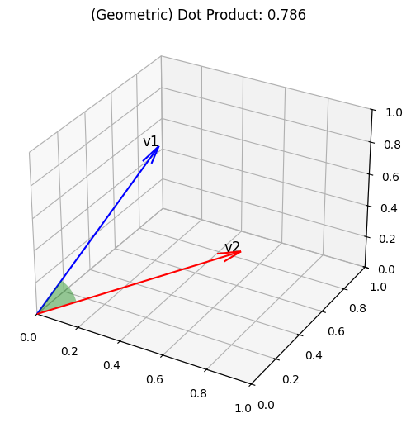
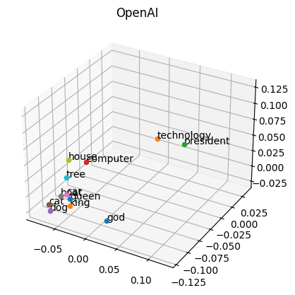
Vector similarity
We compute embeddings so that we can calculate similarity between inputs.
The most common distance measurement is cosine similarity.
def cosine_sim(a, b):
return dot(a, b) /
(mag(a) * mag(b))
For ada-002, cosine similarity values range from 0.7-1
💻 Demo: Compare vectors with cosine similarity
Notes:
Showcase the vector_embeddings.ipynb – document similarity modeled as cosine distance
And we want to calculate similarity and so you might hear this phrase.
, cosine similarity?
That's one of the ways of doing it, but basically what we have, this is a 3D model where you've got some words here and like I said before, you move them around and put them in positions based on what they're similar to.
So if you put animals like cat, dog close to each other and then you put things which are quite different like technology and president their father away, and then you can say to the you once you've got the vectors you can compare the two things and say like how far away are they and then that number is how similar or dissimilar they are.
The reason we use cosine is because it's quite an efficient way of measuring, like if they're close, then the angle will be small and therefore like that's a small number which would be close to one.
And if they're far apart, then that number will be closer to 0 in most cases.
So that's for a 3D model.
But like I said, open AI uses 1500 dimensions, so we can't visualize that on a slide.
But it's basically the sort of how it works now.
Some more notes:
so we talk
about similarity and um I guess my kind of first example is if you think of a 2d
space um like a map um and you say how two how similar are these things by
working out how close they are together um that's one way of looking at it um
the challenge is that you know if you said how similar are um okay let's pick on Florida because I
mentioned that one first um how similar are Miami and Orlando um you know
they're close to each other relatively um but in terms of like other factors
they're pretty pretty different like Miami is by The Beach Orlando is in the middle of the state um Orlando has a lot
of theme parks Miami has a lot of shops and beaches and clubs and stuff so like they are different and you can't just
have two Dimensions to work out how similar something is when we're working with AI the similarity is either a word
or a sentence and so when we when I typed in um something for cold
weather um it kind of Associates warm like that was the warm hoodie and cold
uh cold weather those are similar things because they're talking about temperature they're talking about weather so it puts them in a similar
space in its model so what an embedding model is is it's basically like a huge
space uh where you can give it a piece of text and it will give you the coordinates of
that bit of text in that space and then you can give it another bit of text like a sentence or a word and then it will
give you some other coordinates and you can then work out how close are they to each other uh I've drawn we've drawn
this in like three dimensions here with um some words like house computer tree
dog god king cat um because three dimensions is a bit easier to VIs
visualize but actually the AI works with more than three dimensions it works with
depending on the model hundreds or over a thousand dimensions that's impossible
for us to visualize like our brains cannot you know work that out um so it's
easy for me to explain it in three dimensions but it's actually more than that so Vector similarity or embeddings
is a way of getting like the coordinat of a bit of text in this space that the AI uses to work out how similar things
Once we have vector embeddings, we can compare two vectors to see how similar they are. There are multiple distance metrics that we can use, but the most commonly used metric is called cosine similarity. It measures the angle between two vectors in a high-dimensional space.
Let's look at the similarity between some vectors.
// Open notebook with comparison
**** Notes ******
Remember that you're vectorizing an entire picture or paragraph!
Show similarity for longer strings / RAG chunks
Give examples of sentences that have similar characteristics but mean completely different things – phone numbers, dollar values (1000 vs 1 million)
Show a demo comparing two sentences
Show a demo indexing the Disney movie titles and searching
https://platform.openai.com/docs/guides/embeddings/use-cases
https://www.reddit.com/r/MachineLearning/comments/13aaj2w/d_is_openai_textembeddingada002_the_best/
https://vaibhavgarg1982.medium.com/why-are-cosine-similarities-of-text-embeddings-almost-always-positive-6bd31eaee4d5

Slide 23
Vector search
1
Compute the embedding vector for the query
2
Find K closest vectors for the query vector
Search exhaustively or using approximations
Compute embedding vector
Search
existing vectors
Query
Query vector
K closest vectors
OpenAI
create embedding
[-0.003335318, -0.0176891904,…]
Search
existing vectors
[[“snake”, [-0.122, ..],
[“frog”, [-0.045, ..]]]
“tortoise”
💻 Demo: Search vectors with query vector
Notes:
Showcase the vector_embeddings.ipynb – Disney movie similar movie
Now we're ready for vector search! Given the search query, we compute an embedding, and then we find the K closest vectors to that search vector.
Let's try that out in a notebook.
(Demo: Disney Movie titles including the Marvel Cinematic Universe)
Some more notes:
when we do Vector search uh the first thing we do is calculate the
embedding Vector for the query so let's just call that coordinates for now because I think that's an easier term to work with so Step One is like get the
coordinates for the thing that the user typed in um and then step two like get a
pencil and then like draw around that area and that coordinates you know just as if you were looking at a map um and
you found like the town that you wanted to go to on the map and you said find me everything within 5 miles or 5 kilom um
of that town so you can you could get a a compass and you could draw a circle
around it and say okay here's all the things which are within five miles of that um that is the the closest vectors
or the closest nearest neighbors you might hear that knnn um sometimes mentioned which is basically saying like
what's in that area so with the uh with the vectors what we can do is we can
type in our query we can get the embedding Vector which is our coordinates uh we can then look at what
is in the area um and then it will give us back some other other points which are in the
area um so for example if we uh typed in tortoise and we use one of the embedding
models the open AI ones it would give us back that list like set of coordinates
and then we can search for uh existing vectors um and it would give us things
which are similar to tortoise like snake or frog or um Turtle would be probably a
better one um so like these are reptiles so you know it's put them in the reptile
space um these are um you know things which are kind of green so it's put them
in the sort of green space and they've got all these neighborhoods in the model where they've put bits of information
which are related to each other the model has been built in a way um based
on what open a was kind of trained on so they've kind of got these clusters or
like neighborhoods I guess of uh bits of information in the embeddings so I try
and think of it in 3D because trying to picture in hundreds of Dimensions is impossible um but think of them as
coordinates and you kind of got these spaces where you can look for information
Data & AI talk:
When you did this, you compute the embedding vector for the query, so you take the piece of text that the user typed in.
You turn that into this thing called a vector, which is a series of numbers, and then in your database you've precomputed vectors for the other bits of data.
So you've got all of these points like you've got that graph on the previous slide.
Umm like I said, 3D3D graph or has it gone this one that you imagine you've done that, but for all the things in your database, so you've got all your products in the database laid out in this sort of 3D graph, and then the user comes in and types in a question.
You can do a search based on the most similar bits of information and you can find the nearest ones in a database that supports factors which we now call a vector database.
It's a vector.
Database just means a database which also supports the storing of a vector which is just a sequence of numbers and it has a pre built and like calculations for working out similarity and doing filtering.
So there's nothing.
It's not like a massive difference between a vector database and like a SQL database for example, and in most cases actually you can add Vector support to a SQL database and it's just really the capabilities that are built on top of that.
So you'd say, here's the question.
Calculate a Vector query the vector, search the existing ones and find me all of the most similar bits of information.
So in Openai talk, you could say a word like tortoise and Search existing vectors and it would give you back the things that it found which are most similar like other small creatures or animals.
.

Slide 24


Vector databases in Azure
Vectors in Azure databases
Azure AI Search
Keep your data where it is: native vector search capabilities
Best relevance: highest quality of results out of the box
Built into:
Azure Cosmos DB MongoDB vCore
Azure PostgreSQL services
Eventhouse in Microsoft Fabric
Azure SQL server (upcoming)
Automatically index data from Azure data sources: SQL DB, Cosmos DB, Blob Storage, ADLSv2, and more
Notes:
As you can see, vector search helps us find semantically similar results, and also helps with translation across languages. It's an amazing tool in a search arsenal.
Fortunately, we support vector search natively in the Azure data platform, in many of our databases: Cosmos DB MongoDB, PostgreSQL, and Azure SQL server.
We also have Azure AI search that does vector and keyword search, and includes integrated vectorization for cloud-based embedding.
Some more notes:
so in Azure um we've got a
couple of options we've got um vectors you can store vectors in a database and I'll explain why you would want to do
that in a minute um you can do this in Cosmos you can do this in post sares uh
you can do it in Fabric and SQL Server um that capability is is in preview are
going to be in preview pretty soon um and then we've also got a an entire product called Azure AI search which is
built for um taking existing data from uh
pretty much anything can think of uh like PDFs Word documents PowerPoints uh
blob storage SQL databases and then like attaching a vector or like an embedding
to it so you've got all your data in your database and it will go through each record in the database and then
create the the coordinates of that bit of data um and then you can say okay find me you know products like this uh
and that is essentially what I did in that demo was to take the product descriptions
um for each of the products that I got in my database there were only 16 so it's you know it's quite easy to do um
to take each description and then get the embedding or the coordinates from the AI model store that in a database
and then when the user types in their query I get the embedding of that uh and then I compare it and say like what is
the closest thing I have to what they asked for um it's a different way of thinking of search because normally when
you think of search like you know like a internet search or database search you're looking for words like exact
matches to words from the query in the database
Data and AI talk:
So in Azure we've got and you can add Vector support to Azure databases.
So in Cosmos Mongo DB V core supports vector fields as a Postgres supports it using the PG Vector extension event house in fabric, which I've not used yet and also support in SQL Server is coming soon.
So you can actually add vectors as a field or a property in an existing database and then do vector similarity.
You need to calculate the Vector information which you do using embedding model from Azure open AI or you can take Azure AI search and you can plug in existing data.
Whether that's like a PDF or a SQL database, existing Cosmos DB BLOB stores and it can index that and vectorize it for you, and then it's got all of the search capabilities built in.

Slide 25
Storing Embeddings as Vectors
If a vector is just a series of numbers, do I need a Vector Database?
You can store a vector in any database, you can’t efficiently search over it.
Vector databases give you
A special column type for efficient storage of vectors
Indexes for searching vector columns with similarity algorithms
Some vector databases also give you
Integrated vectorization (it converts another column like text into a vector for you)
Fine-tuned search and filtering
Notes:
um and they're like there's
some that is sometimes really effective but often like you've got people asking
questions in different languages you've got um people being kind of vague maybe they're not using the exact name like
this morning I was uh shopping shopping for a camping stove uh we're going camp
next weekend and I'm looking for like a gas stove and I can't remember what it's
called so I'm just typing in Coleman gas stove and it's giving me some matches based kind of what I'm asking for um but
I'm not specific I'm not typing the exact name of the product because I don't know what it is um Coleman have
decided to call it a fire breather or something ridiculous but um I like as a
consumer I've got no idea what that is U I'm just want a gas stove that's going to work um near the beach so it's always
windy um and I can type in like what's a good camping stove for like a windy
windy place so um we've calculated these these these embeddings these vectors or
coordinates let keep calling the coordinates we've got them and it's just a series of numbers so like why do you
need a special database to to to do it um I mean technically you can and in my
demo actually I've got an example of a uh a homemade Vector database like it's
it does the job but you can use it locally it's really slow and really inefficient but it it does the job um
you could store a vector in any database it doesn't need to be a vector database the problem is you can't efficiently
search over it so you've got these um these vectors and the way we do the
search is basically you know like I said with a map if you just draw a circle around it that's easy to do in two
Dimensions but when we're talking about 1530 two dimensions that's actually
quite a big calculation to work out like the positions of every single Dimension
and then rank everything that we've got in the database and order it and sort it
so the vector database actually most of the technology is on the the the like
the similarity algorithm and the calculation and then ranking the results so when we say Vector database it's
actually because you've got a special column type so you know previously you'd have you know a text Colum colum or for
my price like that's a a number column um or like a currency column um and
you've got a special new column type which is a vector and you've got an index which you can use to efficiently
search over vectors um with different algorithms um some Vector databases also
give you uh the ability to calculate the vectors like you don't have to do that
it does that for you so it can talk to the AI model for you and and create create those numbers um or they've got
like additional algorithms to do search search and filtering

Slide 26
Search multi-modal vectors
Images, sounds, graphs, and more
Multi-modal embeddings - e.g., images + sentences in Azure AI Vision
💻 Demo: Searching images (aka.ms/aitour/image-search)
Notes:
Azure OpenAI + AI Search (app-backend-iwzkudjoxfepe.azurewebsites.net) – prompt => can you identify relation between stock price and stock market trends? Whhat is the correlation between oil and stock market?
So far we've talked a lot about text.
Yes, you can have a text encoder and do vector similarity in text, that is very popular, but this also works on images, sounds, and other media types as long as you have an embedding model like a vector encoder. There are even some models that will mix multiple media types in the same vector space.
For example, one of the capabilities of the Azure AI Vision Service is to map images and sentences into the same vector space, and because it's the same vector space, comparisons are meaningful, so you can do image-to-image search, or image-to-text search, and so on.
Again, similarity means all the same vectors are changing, is applicable to this scenario. Finally, we're seeing this emerging pattern, this is very old/very new, but in a world where you can search for pictures and then you can use GPT-4 Turbo with Vision to understand the picture. You pretty much can do RAG on pictures too, like you can read a chart, for example, and interpret what's going on
// Demo: Notebook, RAG app with vision enabled
Data and AI talk:
You can also do multimodal Vector Search and this is where things get pretty pretty amazing.
So let me show you a demo of this one, so I've included in.
I've included in the demo.
Uh, GPT, visions, support, and let's clear this.
And one of the documents I gave AI search, uh, was a PDF that had a bunch of company documents information on it, as well as some graphs and some reports.
And and it's indexed that for me and it's looked at the graphs for me.
So when I'm doing a search, I can actually ask to get questions like.
Is there a correlation between oil prices and stock market trends and it's going to not just look at the text in the document, but actually what images were in the document and what meaning did they have?
And it's done that because the GPT, the embeddings models the newer ones, especially GPT 40.
So 4 O is the one that came out just a few months ago, and you can give that and images and it can infer a lot of meaning from the images.
So it's saying to me, OK, yes, there's a correlation between those two things.
Specifically, the correlation between oil prices and the S&P 500 is .6, and it's found that because it's found this picture, umm, as part of one of the PDFs that I uploaded and it indexed that it it read the table and it did some processing of the image and then it worked out like oil here and S&P 500.
Here is 0.6 in the table and it's given me an answer like that's not, that's not text I've given it.
That's a picture.
t's a screen shot of a table and it's read that as paused it and it's included that in its thought process, and it's included that in the search results.
So that's great for when people have got documents that have got maps, charts, diagrams, they've got slides for example, or they've got and even does sound and video as well and and a great capability is in that in Azure cognitive services, there's a bunch of additional functionality that's built on top of GPT so that we can do some sort of preprocessing of things like the tables and the images to improve the quality and the parsing from the PDF.
Which massively improves the quality of the search result.

Slide 27

Optimal relevance: Hybrid search + Semantic ranker
Question: "What underwater activities can I do in the Bahamas?"
Keyword results
1 | Scuba Diving in Bahamas
Fusion (RRF)
Reranking model
1 | Scuba Diving in the Carribean
2 | Scuba Diving in Bahamas
3 | Water skiing in Seychelles
1 | Scuba Diving in Bahamas
2 | Scuba Diving in the Carribean
Vector results
1 | Scuba Diving in the Carribean
2 | Water skiing in Seychelles
💻 Demo: Compare text, vector, hybrid, reranker (aka.ms/aitour/search-relevance)
Notes:
Show search_relevance.ipnyb
For optimal results, we need more than just vector search: we need a full hybrid search. That means that we do a vector search with the embedding, we do a full-text search with the keywords, we merge those results with an algorithm, and then finally, we apply a re-ranking model that sorts the results according to the user query. That re-ranking model is called "semantic ranker" in Azure AI search, and it's based on the same ranking technology used by Bing search.
// Demo: The best way to see the differences between search retrieval strategies is to see it for yourself. Let's go through this notebook.
// Run cells, explaining each one.
Some more notes: keywords uh and I have done this for my for my demo app so uh we do a keyword search so the keywords in here probably
would be Bahamas I think that's the most important part of my keyword search is I've specified specifically Bahamas and
then we can do a vector search like a similarity search and those are probably going to come up with different things
because the keyword search would say Okay um I found one thing that has
Bahamas in it um so like I'm going to match that pretty high um and that's
like scuba diving in the Bahamas like that's a good result uh the vector search would come back and say okay
here's some similar things and it doesn't know it it doesn't rank each word in
terms of its importance so like it says similar things underwater water activities Bahamas tropical places warm
places like those are all kind of in the same neighborhood so it could come back with a result like number two which is
water skiing in the SE shells that's not underwater unless you're doing it wrong
or you falling in and the SE shells is nowhere near the Bahamas but as far as
like the similarity is concerned the SE shells is a tropical Place uh it's like
a set of islands the Bahamas is a set of islands um so like it will give you
information like that um and so what you can do is you can merge those results
together uh using like a special algorithm which is called RF but it basically just kind of Zips them
together um and that would give you like this this order so we'd get like scuba
diving in the Caribbean scuba diving in the Bahamas and then like it would put water skiing in the S shells last um in
Azure AI search there's an additional capability where we can rank uh the the
order basically it looks at the likelihood of each result being the one that that you wanted uh and it would
switch number one and two around so uh that's an extra feature that's in AI search only um and there's a an
interesting paper about that and how it works um but if you're working with large amounts of data and large amounts
of vectors um often this sort of extra Fusion step or the reranking step can be
really important
Data and AI talk:
Umm, I've talked about Vector Search.
Anthony Shaw 29 minutes 43 seconds
Umm, there's a flaw with Vector Search and the floor is that.
That uses similarity to find the most relevant answer, and sometimes similarity is not actually a good tool to use.
So for example, if I ask the question what underwater activities can I do in the Bahamas and what we actually want to do is a hybrid search and I explain why.
So hybrid search is where you do a traditional keyword search.
So in this case I've searched for.
Uh, I've got underwater activities and Bahamas and I also want to do a vector search which finds similar bits of information.
So let's say hypothetically keyword results gives me defines Bahamas as a keyword and it matches that specifically.
So keywords says OK, I found some information about scuba diving in Bahamas.
Vector results could say ohh I found scuba diving in the Caribbean which is yeah close and I found a water skiing in the say shells because seashells as far as the AI is concerned is similar to the Bahamas.
Now there are completely different sides of the planet.
Umm, but it's a tropical place and it's sunny and it has beaches and it's similar.
So like if you ask the AI how similar is the say shells and the Bahamas, it would say very similar.
You know, they're very they're more similar than Tibet, for example, and the Bahamas.
So it would actually include a result like that and it's answer.
If you just did similarity search, but when the users asked the question what can I do in the Bahamas?
They don't care what you can do in the same Charles and like they're not going to the, say, shells.
They're not interested and they're just going to get annoyed with the results and this is where you need to kind of combine like a traditional keyword search with a vector search to find specific bits of information.
And I'll give you some other examples.
So AI is vague and can be imprecise with Vector Search with things like names, numbers, places, addresses, anything which needs to be really specific.
So if you said tell me about products that are less than $1000, the $1000 part, it sees that as a number.
It doesn't know that it's 1000.
It doesn't know what less than 1000 is.
It doesn't care really about the difference between 1002 thousand.
It just sees them as numbers, so it sees them as similar bits of information.
So in cases where you just do Vector Search and you're just using a vector database, you can often get these kind of vague results which are not you asked for.
But I'm kind of related, but not in the ways that are important.
So you merge those two things together using something cool fusion, which is kind of basically just sticks them together in a fairly arbitrary order.
Yes, and most vector databases you've got are off Support, so they can.
You can do keyword and Vector Search with AI search.
There's a Passcode: reranking model which goes on top of that, and then it basically reorders them in a way that makes the most amount of sense, and based on what the user has asked for.
This is a proprietary technology as built specifically for AI search, and it's only available in AI search, and it improves the quality or the retrieval of the of the results that you get back.
Umm, it outperforms keyword vector and hybrid which is the the other options we've shown there in basically every benchmark it was given.
There's a really interesting paper – aka.ms/ragrelevance on this that's published by the AI search team that talks about like how this performance works.
So in that case you can ask it questions and it will find the most relevant bits of information and then give it to the LLM to give you a spoken answer.
And now there was actually a lot in that demo that kind of happens behind the scenes that you haven't seen.

Slide 28
Example database schema
Defined with SQLAlchemy ORM:
class Item(Base):
__tablename__ = "items"
id: Mapped[int] = mapped_column(primary_key=True, autoincrement=True)
type: Mapped[str] = mapped_column()
brand: Mapped[str] = mapped_column()
name: Mapped[str] = mapped_column()
description: Mapped[str] = mapped_column()
price: Mapped[float] = mapped_column()
embedding: Mapped[Vector] = mapped_column(Vector(1536))
Notes:
TODO: Generating the embedding column
Show the cosmos db data explorer select top 1 from products p;

Slide 29
Demo – Vectorizing data in Azure Functions
Notes:
let me show you the
diagram because that's GNA kind of hopefully put it together so we've got a web app which
is my um super simple it's only three pages uh I've got a database which is in
Cosmos DB I've got this Vector Sur capability and I've got like a I'm using
Azure functions um to kind of Drive the the behavior in the background so uh when I type in um my
search um something for a cold
day
then you'll see here um I've actually got just the keywords um and this kind
of goes back to my slide about the uh water skiing of the Bahamas like often
you want to match something in particular so that's called a crimson KN hoodie so if I just search for Crimson
KN hoodie I probably want that product first um like if I if the user types in
the specific name of the product that's probably what they're looking for so um what we've actually done in this sample
is um when they type in the search I'm actually talking to um the GPT model uh
that might seem confusing like where's the chat box why are you talking to GPT
um but the reason is um I've got a special prompt um and I put this prompt
together because when the user is typing a a question
um actually let me give you another example uh I've put like a few different
languages in here as well so um you can switch to uh like uh Spanish French a
German and a Japanese and Hindi um now the database is in English um but like
if I typed in uh switch languages
um uh if I typed in uh come
on uh that says some address all right in Japanese um um if I typed in some
address (マフラー ) it's going to search for some address um and it's done that because
I've got this extra step in the middle and the extra step is this prompt and
the prompt is basically like I was saying earlier it's like a story that you're trying to tell and it's going to finish the story for you and the opening
part of the story is I want you to generate a search query for a SQL
database based on a user query don't generate the whole don't generate like a
SQL statement that will end really badly um only generate like some
keywords uh use like Boolean operators if the user has been specific about what
they want to exclude in the search so if the user says um give me something for a
summer but I hate the color blue then I want you to explicitly say but not blue
um if the query is not in English always translate the query to English if you
cannot generate a search query just return the number Z so this is actually a prompt that I've
given um the GPT model GPT 40 and um I kind of experimented with
this prompt uh in the chat playground so I mentioned that there's lots of different types of models that you can
do um and in Azure AI Studio you can come in you can deploy uh I
can uh from here uh oh that's the one Sacha announced today so o1 preview and
o1 mini is now available um GPT 40 and GPT 40 mini so when you're doing this
kind of like query prep prompting stuff like that I'd recommend using 40 mini
because it's it's cheap it's fast and it's effective um which is a win-win win and um that model and the I'm using 40
the full 40 here um is great for this type of task which is like I want you to
take a user question user query and make it into something I can search in a database for um and in the uh playground
I can then say like generate uh oh I've still got Japanese keyboard
on uh generate a user query for um you like best
cheeses from France it's a controversial uh question um it would
say best and cheeses and France like that's what it's come up with and that's kind of that's a pretty good pretty good guess
as to like a keyword uh capability um I've then gone a little bit further here
where I've given it a bit more of the story so I've said you know here's an interaction so when I'm talking with the
with the completion you can do this in AI Studio as well if you go to uh I
think it's in examples that's it that's the one you can kind of give it an
example interaction so like the user said this and you should have said this like that's what you were doing here and
you can add a few examples this is called f shot training and it's it's basically a technique where you're just
adding a bit more context to it and saying like here's how I want you to behave um you know if they type in a
really nice winter jacket I want you to respond winter jacket uh if they typed in sum address again then I want you to
say sum address so like it it's you've giving it some examples and therefore what it's doing is going to be close to
what you want so it's then spat out this um keyword for me so it's got the the
thing that it's looking for the keyword search in our database then what we need
to do is we need to calculate the the embeddings the vectors for like the product descriptions so like that's the
the name and the description so we can do that using the text embedding model
and um what we do is we basically go through the uh the database and we
create a um an additional index or an additional field and we put the
embedding in there um I've done that in Cosmos because um that's an easy one for
me to work with and I've specified I've got two uh embedding Fields they're both
floats um they're both 1,24 dimensions one of them is the description and one
of them is the picture like the image and then in my code I've also said like I want you to index those um so
when I do a query I basically say like use the embedding as the thing that you're measuring and um the cosine
similarity is is one of the ways of calculating things in that area or things that are most similar to it and
then in the app uh when I've got um the
search feature I'm going to do like a couple of things so I've got my search query that comes in that's the thing the
user typed in so it's like step one is to generate to take the query give it to
GPT so it does that stage where it kind of rewrites the query to make it more keyword looking um step two which is
where I get the embedding uh which is you just call an API like that's there's
no maths involved this is great like you just say okay I want you to use uh
texting Bing 3 small I think I'm using here call the API get the data uh and
then get that back and then the last thing I've got is search products which uh in my case I'm using
Cosmos uh to do a search which is just down here um basically it's a it's a SQL
query um where there's a special field that's called that's the keyword search
and then I've got a vector search which is um basically calculate the distance it's like a function you put in the SQL
query in the in the sample as well yeah sorry to jump in if uh we do have about
10 minutes left we did have another question is it okay to to ask perfect and apologies in advance if I AB butcher
any parts of these questions um so uh Nicola is asking Microsoft research and Intel Labs used lanb op SRC Vector
database implemented in Rust for low latency searches of image frames and
videos have you done benchmarks comparing Cosmos pgms
SQL um okay so comparing those three Technologies I guess you your um I think
your question is like the comparing them like how quickly they can calculate the distances uh I have not somebody may
have done already I'll I can have a look later and maybe I'll share with you anest like if I'll find any resources
like um whether someone has done that as far as the vector database is concerned
they're all using the same set of algorithms they all use the same calculation and the vector like you have
to compute the vector so like in the code here I'm fetching the embedding by
calling openi API um like cosos is not doing that uh for me I have to go and
get that from the API and give it to the database so in my database I've got the
uh the vector information for the products and I've created that ahead of time so I've you know basically copied
that text got the embedding put it in the database um now the the the other thing
we've got in here is how it still open no I didn't um the
other consideration I wanted to mention is that if somebody changes the description or changes the product um
like you want to update the vector uh and this is kind of an additional step
which is like um in Azure functions this is why I've picked Azure functions because um if I go down a bit I've got
some extra code here okay so this is an extra bit of code that I've got which is a cosmos DB trigger which is called
whenever someone changes the data in the database um so like I'm assuming that
they've changed like the name or the description of the product and therefore like the the coordinates the vector
needs to be updated so um this is basically a callback uh code which is like Cosmos
will call my function and it will run this custom bit of code to and fetch the embedding again um from openai if it's
changed so like it sees okay did you change the name or the description of the product if you did let's go and
update the embeddings and store that back in the database so that next time you do a vector similarity search it's
going to give you the right results um so considering we've only got a few more minutes left so that is the
that's the kind of query prep and the similarity search stage now the other one let me change
back to English um is is the matching so this one um we've kind of got I've done
two implementations of this um to kind of show you a difference between because we said we're doing multimodal search so
multimodal search basically means that you've got not just text uh you can do images you can do videos you can do
audio uh whatever that whatever that looks like and so in this image here um
there's two ways of doing this uh this search one is that in the playground we can uh um we can actually do attachments
so like if I do attach that um describe
what the person is wearing like this is a prompt um GPT
40 uh the new Omni model will um like look at the image and then using
like like classification how it's been trained it will then come back and say like they're wearing a light blue thin
jacket with a patch on the front they have a green back backpack with a pink fluffy keychain attached to it they're
also wearing a wristwatch so it's described that for me now what I wanted to do in my search was um search for
products like what the person is wearing so when I do a match uh what I actually
did in the code was to do what I just showed you in the uh in the studio so in
the playground um was to basically just make a call to gp4 and say say describe
what the person is wearing and attach the picture so that's all I've done I've just done that behind the scenes um so
in this in this match I've said generate a text description of the clothes worn by the person in the image and then I've
included the image that the user uploaded so it comes back with some text
we calculate the embedding of that text like the position of the text and then we do another similarity search so we're
basically doing the same thing that we had on the search page um but this time the text that we're using to search is
this text which is the person who's wearing a den jacket so it's going to
match it's going to match the green backpack it's going to match the denim jacket um so that is like the text
version of this um I've seen some limitations like it um if you're just
doing text descriptions to do search it won't necessarily find like all the characteristics or if you uh actually
sorry that was doing images but if text then it will give me slightly
different results I think Okay so we've got it's if we just
do text um and we use this this implementation it's overemphasized blue
denim so it's got a denim jacket and some jeans um so that is like GPT 40 to
describe the image to get the embedding of the description and then to sech search for it there is another model you
can use um which is called Florence and this is part of azure computer vision um
and that one is actually a special embedding model specifically for images
and so if I use the um the same picture it will actually analyze different parts
of the image uh and then find things which are similar so if I use that model
it gives me the backpack and the and jacket whereas if I just use the textt descriptions it will
overemphasize um like the denim part and it will just give you denim products uh it doesn't look at like all the
characteristics this is also important with things like um so I've got this uh this person with
like the played shirt for example like if I use that one with text
descriptions only uh it will kind of
focus on the fact that there's a lot of green in that image like so it's said okay green and beige shirt and therefore
it's given me a green flannel shirt which is right and it's also given me another green t-shirt which is not what
I wanted um so like that's kind of the difference I wanted to show you between
the text description approach with GPT 40 and the image embedding using the
Florence model um is that the Florence model will focus more on like the actual
parts of the image and the patterns and it will give me some jeans um they're the wrong color but it's it's better
than a green t-shirt um so yeah that's what I'd recommend is to kind of play around with this and to use the uh the
chat playground in AI studio um and then
you can kind of experiment with different prompts give it some different pictures um and that's kind of how what
you have to do with with with AI is you have to kind of start to build up more and more like training data and test
data and just kind of experiment with it and that's what I've been doing for this search uh and for the match outfit
feature and kind of the point I want to finish on is that um you know we've got these two capabilities now in an
existing website like there's no chat box on the side um we've got a search
page that search page now supports typing in search queries in any language
um it could be literally anything um it's it's a supports you typing like uh
find me a like jacket like the one uh FS wor in Happy Days if anyone's
old enough to remember that um like that is a a ridiculous query to try and I
don't actually have one like that in the shop but it's that's closest um like
that it would be extremely difficult to do with just SQL um but GPT can be used to build a capability like that um where
the prompting and the interaction is just done in the back end the user doesn't need to see it you're just enriching an existing AI an existing

Slide 30
What we are building today
Web App
Database
Vector Search
Serverless Function
AI Models

Slide 31


Azure Functions for intelligent apps
Preview of Azure OpenAI Triggers and Bindings
RAG (work with your own organizations data)
Embeddings and search
Pluggable with Azure AI Search, CosmosDb for Mongo DB, Azure Data Explorer
Configurable models for embedding and search
Integrate with existing http & event triggers for real-time data ingestion
Chat and assistant skills
Chat with OpenAI models with automatic persistent history
Assistant skills trigger to extend capabilities of OpenAI model
Text completion for content summarization and creation
Input binding that takes prompt or content and returns LLM response
Durable Functions for chaining and orchestrations
Notes:
Integrate Azure Functions, to build serverless endpoints to support chatbots or AI assistants with Azure OpenAI; Bring your own data, process it, and store in vector DB for Retrieval Augmented Generation or RAG; Build functions as plugins for generative AI platforms like OpenAI; Or parse data to the right format for training models.
Now, secure network boundary is critical for enterprise solution development and compute size selection offers autonomy to support your app needs. Today, I am excited to share with you that we are bringing these enterprise capabilities to the serverless billing model for Azure Functions, offering more powerful than ever burst scale to support your intelligent app development needs.

Slide 32



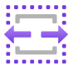
Azure Functions on Azure Container Apps
Generally available
Build multiple app types, containerized microservices that share common Container App environment
Develop your way with integrated programming model with triggers and bindings
Seamless end-to-end development experience
Scale dynamically and pay-per-use

Slide 33
Hands on app building
Notes:
In this section, the trainer will show the application and walk through the different stages to get it working.
Setting up a storage container
Configuring a serverless function in Python to run whenever pictures are added to the storage container
Converting an image into an embedding
Setting up a vector database
Storing embeddings in a vector database
Creating search queries and similarity functions
Improving our search page
Adding a user-provided image upload to the site
Doing text-image and image-text relevance queries
Filtering data in queries

Slide 34
Workshop - Goals
Aka.ms/pythonaiworkshop
Azure AI Proxy Playground (mango-bush-0a9e12903.5.azurestaticapps.net)
Build python functions for effective search query prompts using AI models
Build python function to describe the image leveraging AI models

Slide 35
Considerations for Production

Slide 36
Are the answers high quality?
Are they clear and understandable?
Are they correct? (relative to the knowledge base)
Are they formatted in the desired manner?
Yes, according to the information provided in the PerksPlus.pdf document, underwater activities such as scuba diving are covered under the program.
Do the perks cover underwater activities?
Yes, the perks provided by the PerksPlus Health and Wellness Reimbursement Program cover a wide range of fitness activities, including underwater activities such as scuba diving. The program aims to support employees' physical health and overall well-being, so it includes various lessons and experiences that promote health and wellness. Scuba diving lessons are specifically mentioned as one of the activities covered under PerksPlus. Therefore, if an employee wishes to pursue scuba diving as a fitness-related activity, they can expense it through the PerksPlus program.
Yes, underwater activities are included as part of the PerksPlus program. Some of the underwater activities covered under PerksPlus include scuba diving lessons [PerksPlus.pdf#page=3].
Notes:
For a RAG app, a high quality answer must be clear, correct, and formatted correctly. Most answers from LLMs are clear, but they may not always be accurate according to your domain, and they may not be formatted the way your app expects. For example, the first two answers are correct, but only the third answer here contains a properly formatted citation.
Data and AI talk:
So once you've done these things and you've got a a RAG, which is this app here and we can ask it all sorts of phone questions and interact with it and look at the thought process and we can give it more data, add more data to the index and and then you know in a few months time there's a new GPT model that comes out or we get a complaint from a user that says, oh, I asked it this question, but the the question, you know, the answer it gave me wasn't really relevant.
Why is this happening?
Umm, so with the design of any of these you need to be looking at like are the answers high quality instead of just saying?
Ohh, here's our RAG application and then just giving giving it to users and seeing what they think and so are there responses clear?
Are they correct?
That's super important.
And are they formatted in the right way?

Slide 37
What affects the quality?
Large Language Model
Question
Search
Search engine (ie. Azure AI Search)
Search query cleaning
Search options (hybrid, vector, reranker)
Additional search options
Data chunk size and overlap
Number of results returned
System prompt
Language
Message history
Model (ie. GPT 3.5)
Temperature (0-1)
Max tokens
Notes:
There are so many factors that affect the answer quality, since there are multiple steps in the RAG process with their own parameters. We've already discussed that many factors affect the search results. There are also many options for the LLM steps that we use, like what model we use, what prompt we send in, what temperature we set, and more.
Some more notes:
So and what impacts the quality is the well, first of all, the quality of the question, but you can't really control that.
You can't really control how users ask questions.
You know they will use spelling mistakes.
They'll ask things which are vague and so you can't really do anything about that, but you can process the question in a way like I showed with the sort of double LLM technique where the LLM.
First kind of prepares the user question in a way that's more searchable and you can clean the query or you can kind of experiment with different search options.
So whether you want hybrid Vector Search only or reranking and you can tweak the options, you can experiment with the size of the chunks and how much overlap you want between chunks and how many results you want.
So all of these things are like parameters that you could be experimenting with and what we kind of recommend with this is that you.

Slide 38
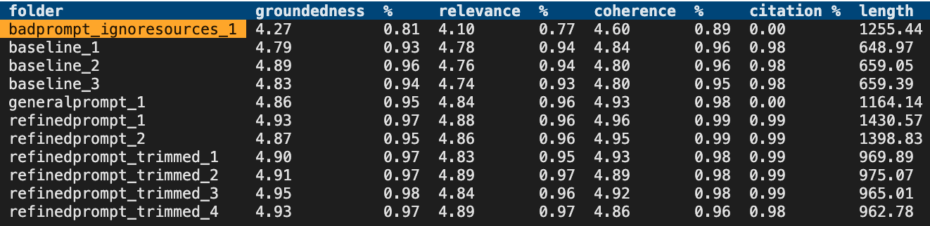
Evaluation approaches
Evaluate the retrieval system
Recall, precision, NDCG/MAP
aka.ms/ragrelevance
Evaluate language models
Shifting space, many metrics, consider your task.
chat.lmsys.org/?leaderboard
Evaluate the full RAG stack for quality and safety
AI Studio or promptflow-evals for GPT-based evaluations and metrics→ At Build: BRK107:
aka.ms/ragchat/eval
Basic SKU now supports up to 3 partitions, up from a single partition
Limits are GB/partition
Notes:
You can start with the options that are the best according to research. Then, to ensure that they are working well for your particular use case, you need to run evaluations. You can evaluate the retrieval step and language models independently, but the most important evaluation is of the answers that come out of your app. You can use Azure AI Studio to run those evaluations in that portal, or use the PromptFlow evaluations SDK to run them from your code. Check out our evaluator repository for an evaluation flow that's optimized for RAG chat apps, and gives you command-line tools for reviewing the results.
Data and AI talk:
And if you really if this is like a production RAG that's going to be used by a lot of people that you introduce an evaluation tool and there's a link here AKA dot Ms Slash ragrelevance and that shows you how to set this up and it will evaluate the the retrieval mechanism.
So like the search and then in AKA dot Ms Ragchat eval you can use this tool which is the evaluation tool to look at some documents and you give it a set of questions and expected answers or expected results and then you can kind of tweak the different parameters in terms of the prompts.
The uh.
The prompts for the like the Search question, the the the prompts for the Search prep and then kind of see how that impacts the quality of the results and the retrieval, and then once you've done all of those things and

Slide 39
LLM Ops for LLM Apps
1. Ideating/exploring
2. Building/augmenting
3. Operationalizing
Identify business use case
Run app against sample questions
Run flow against larger dataset
Deploy app to users
Try different parameters
Evaluate answers
Add monitoring and alerts
Connect to your data
Change defaults
Evaluate user feedback
Customize prompt for domain
Improve the prompt and orchestration
Satisfied?
Yes
Satisfied?
Yes
No
No

Slide 40
Manual
experimentation
Notes:
And gaining intuition

Slide 41
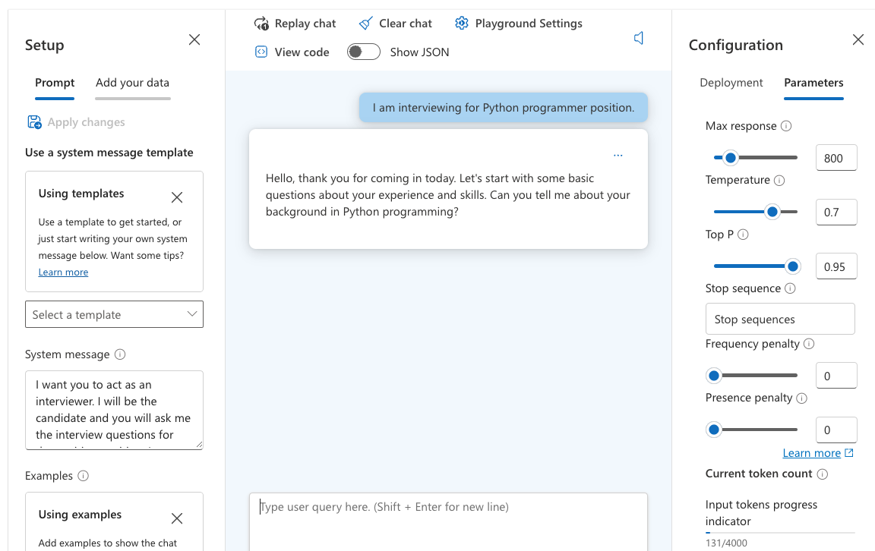
Experimenting with quality factors
Find an easy way to experiment with settings in your LLM app.
Azure OpenAI Studio Playground →

Slide 42
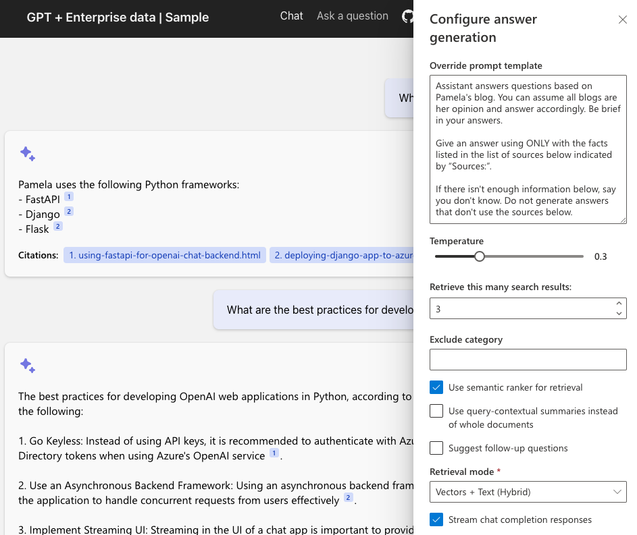
Experimenting with quality factors
aka.ms/ragchat
“Developer Settings” →

Slide 43
Automated
evaluation
Notes:
And gaining intuition

Slide 44
AI RAG Chat Evaluator
A set of tools for automating the evaluation of RAG answer quality.
Generate ground truth data
Evaluate with different parameters
Compare the metrics and answers across evaluations
https://github.com/Azure-Samples/ai-rag-chat-evaluator
aka.ms/rag/eval
Based on the azure-ai-generative SDK:
https://pypi.org/project/azure-ai-generative/
Notes:
And if you really if this is like a production RAG that's going to be used by a lot of people that you introduce an evaluation tool and there's a link here AKA dot Ms Slash ragrelevance and that shows you how to set this up and it will evaluate the the retrieval mechanism.
So like the search and then in AKA dot Ms Ragchat eval you can use this tool which is the evaluation tool to look at some documents and you give it a set of questions and expected answers or expected results and then you can kind of tweak the different parameters in terms of the prompts.
The uh.
The prompts for the like the Search question, the the the prompts for the Search prep and then kind of see how that impacts the quality of the results and the retrieval, and then once you've done all of those things and

Slide 45



Ground truth data
The ground truth data is the ideal answer for a question.
Manual curation is recommended!
Generate Q/A pairs from a search index:
python3 -m scripts generate --output=example_input/qa.jsonl
--numquestions=200 --persource=5
documents
prompt + docs
Q/A pairs
Azure
AI Search
azure-ai-generative
SDK
Azure OpenAI

Slide 46

Evaluation
Compute GPT metrics and custom metrics for every question in ground truth.
Evaluate based off the configuration:
python3 -m scripts evaluate -–config=example_config.json
gpt_coherence
response
+ ground truth
gpt_groundedness
question
prompt
metrics
gpt_relevance
length
Local endpoint
azure-ai-generative
SDK
Azure OpenAI
has_citation

Slide 47
Review the metrics across runs
After you’ve run some evaluations, review the results:
python3 -m review_tools summary example_results

Slide 48
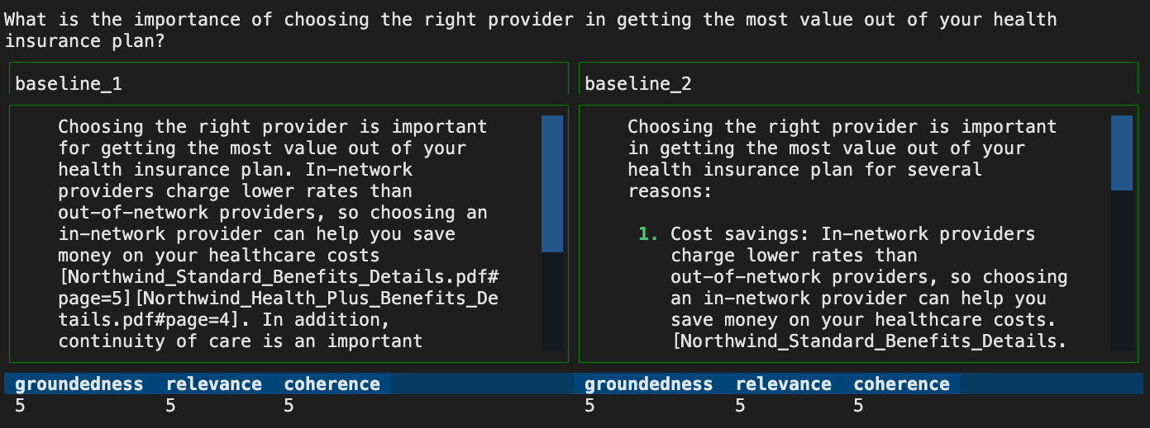
Compare answers across runs
python3 -m review_tools diff example_results/baseline_1
example_results/baseline_2

Slide 49
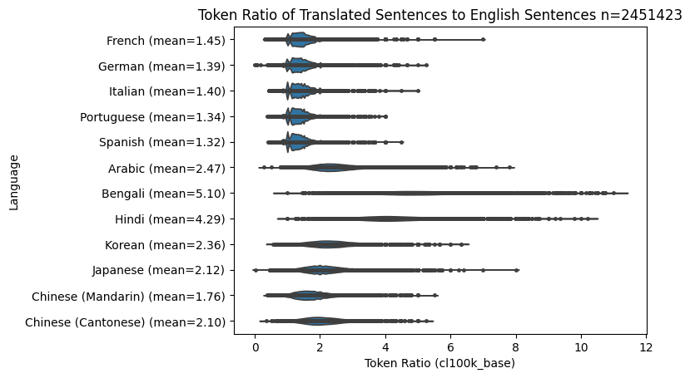
Localization for LLMs
Notes:
The Text to Tokens ratio is higher non-English languages. The general rule of thumb that tokens = text length/ 2 is not valid for other languages. Especially Bengali and Hindi which do not tokenize very efficiently.
Use a token-based splitting library.

Slide 50
Text Splitting by Tokens
The most effective model for splitting any language into a desired number of tokens is the Recursive Character Splitter combined with the Token-Based splitter:
from langchain_text_splitters import RecursiveCharacterTextSplitter
text_splitter = RecursiveCharacterTextSplitter.from_tiktoken_encoder(
model_name="gpt-4", # required for byte-pair encoding model
chunk_size=500, # desired chunk side
chunk_overlap=0, # 10-20 is efficient for overlap
)

Slide 51
Monitoring AI Applications

Slide 52



OpenTelemetry Architecture
Instrumentation
Collector
Exporter
Traces
Long term storage
Search
Automated Instrumentation
Client Instrumentation Libraries
Custom Instrumentation using the SDK
A service proxy of all instrumented data.
Telemetry Data
Metrics
Logs
Your Application
User Interface

Slide 53
Observability Concepts
Traces
Metrics
Logs
Trace units of work are called spans
Spans can have attributes
Spans are created by instrumentation libraries or manually via the SDK
Spans are nested
Spans have kinds
Client, or Server,
Internal,
Producer or Consumer
Metrics are measurements captured at runtime
Metrics are created by meters
Meters are defined in instrumentation libraries or manually via the SDK
Meters can be aggregate or live
Logs are a timestamped text record
Logs can be structured (with data) or unstructured (just text)
Log exporters can plug into existing logging infrastructure

Slide 54

AI SDK Support for OpenTelemetry
* requires additional code
Traces
Metrics
Logs
Semantic Kernel .NET
OpenAI SDK Client (Python, JavaScript)
*
Azure SDK (Python, JavaScript, .NET)
PromptFlow (Python)

Slide 55
3rd Party Support for OpenTelemetry
* requires additional code
Traces
Metrics
Logs
LangChain
Elastic [1]
Redis [2]
LlamaIndex [3]

Slide 56
Securing your RAG
Notes:
Now let's talk about security. If you're building an app for internal use in an enterprise, you want to ensure that it can only be accessed internally.

Slide 57
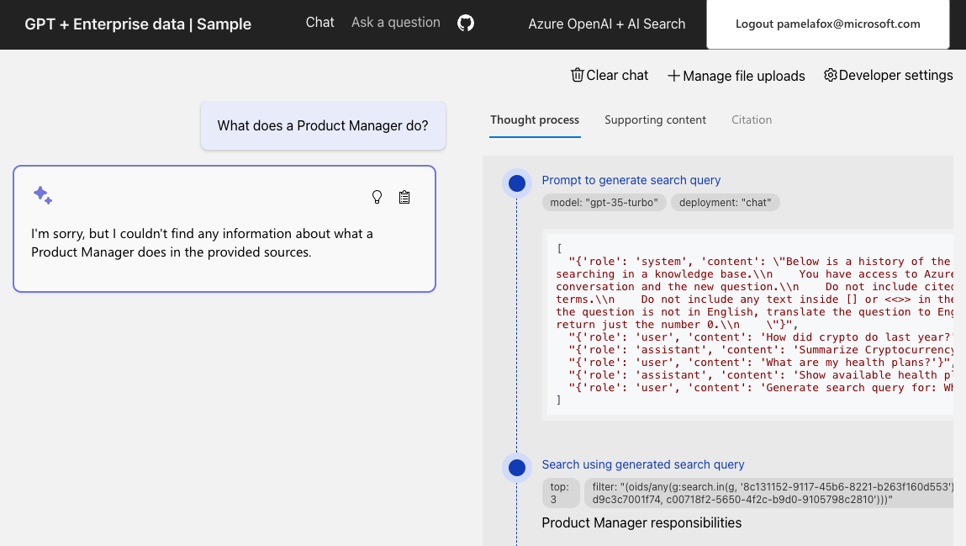
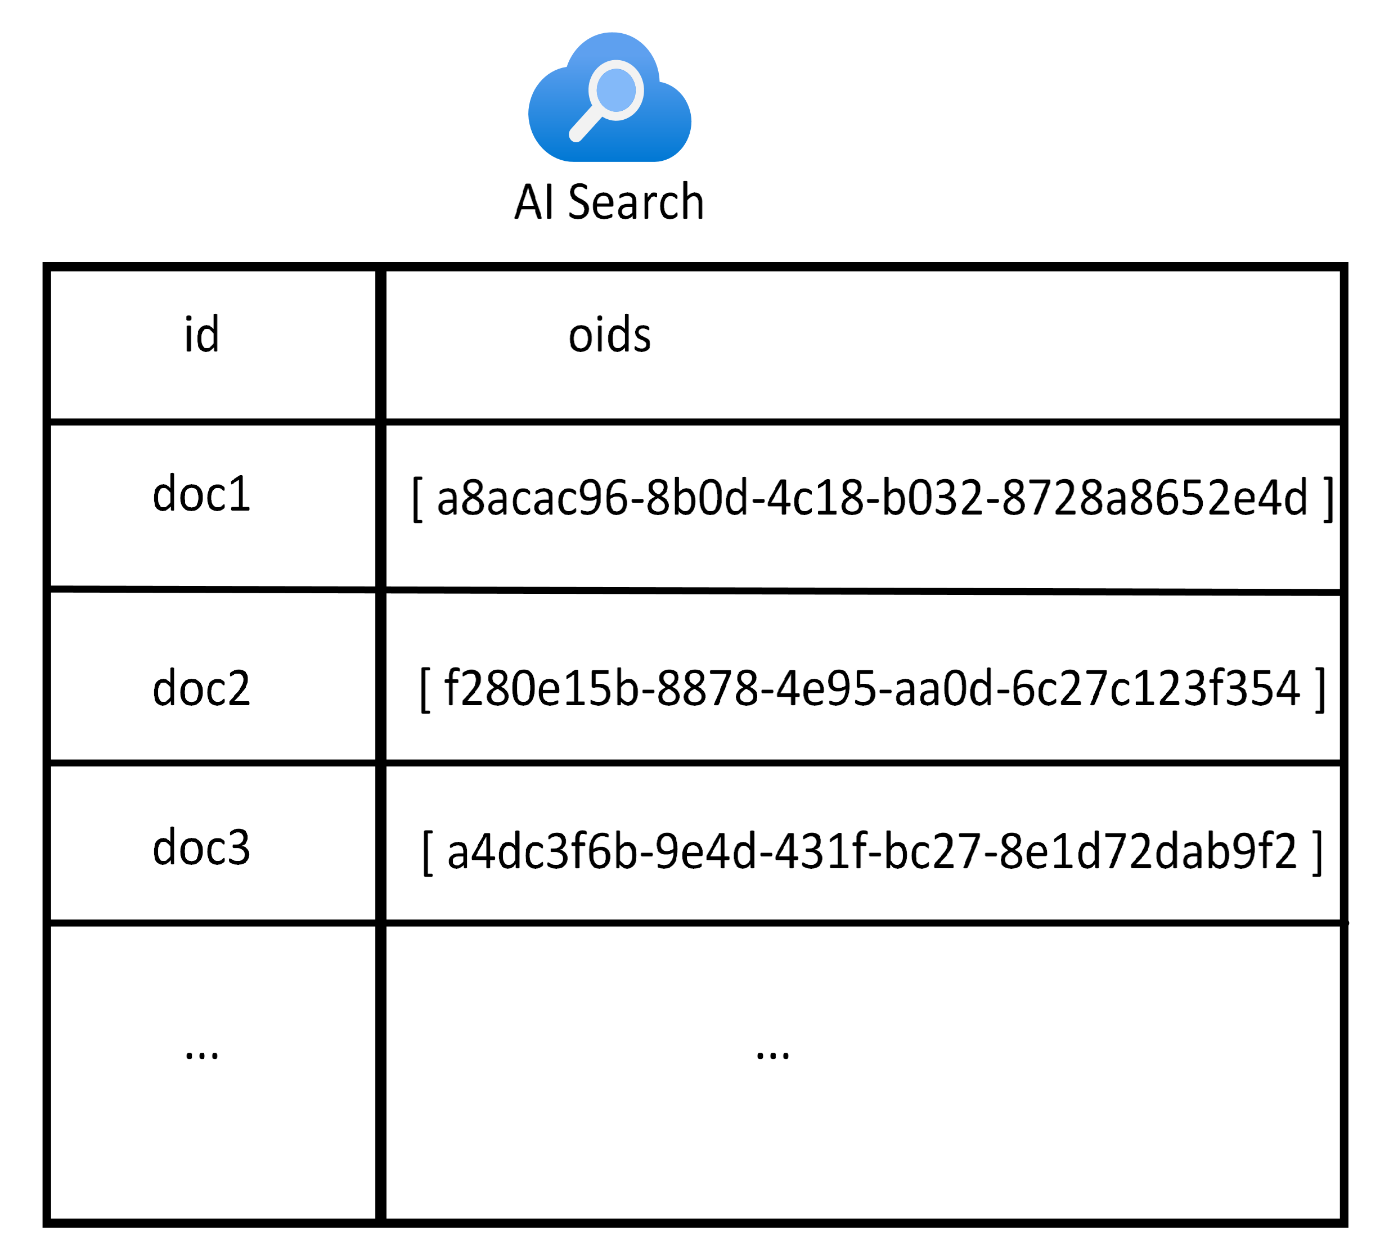
User login and data access control
aka.ms/ragchat/acl
Search index includes fields for oid and groups from Microsoft Entra:
Notes:
One way to secure your RAG app is to add user login to the app, to enforce that only users from your organization can login. When you enable this option, you can also allow the users to upload documents for their own personal search needs, and enforce data access controls in the search filter.
publishing a an app on the Internet where you can ask information about private company documents is not always the best idea.
Yeah.
So the first question we often get asked is can every aunt can every user ask the same question and how do we get it so that only certain users can see or find that information about certain documents.
And because we're using rag instead of fine tuning or like looking at public information, then you can use the filter part which I mentioned earlier to you know only look at certain indexes or only look at certain documents.
So if you're processing documents and indexing them for for RAG, then you want to attach metadata about, you know which user group can see this.
How confidential this is this document and these are fields and the database.
So when you're doing the Search, whether that's what AI search or a different Vector Search, you want to filter out only the documents, only the best of information that that user should see first, and we've got a demo of this at that link, AKA Ms Slash ragchat Slash ACL where we take some additional claims from entra ID.
So once the user logs into the site and we have some additional claims and then include those as a filter.
So an AI search you say, OK, filter out only things which this particular user can see.
All this particular OU can see or whatever it is in the directory.

Slide 58
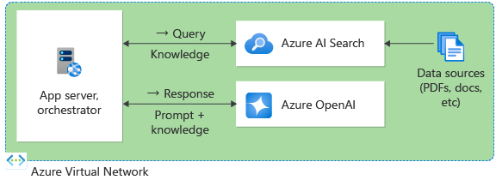
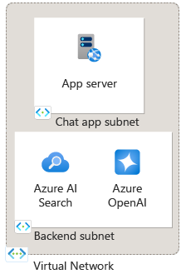
Private network deployment
Put all resources in a virtual network:
Use subnets for further isolation:
Notes:
Another way to ensure internal access is to deploy it to a virtual network, with all the services available via private endpoints, and access only from inside the virtual network.
Uh, you can also deploy all of this in virtual networks in Azure, and there's a version of their demo completely isolated from the Internet.
So if the data sources and the cognitive services and all the back end stuff needs to be offline and only accessible via VPNs or site to site, then you can do that as well.

Slide 59
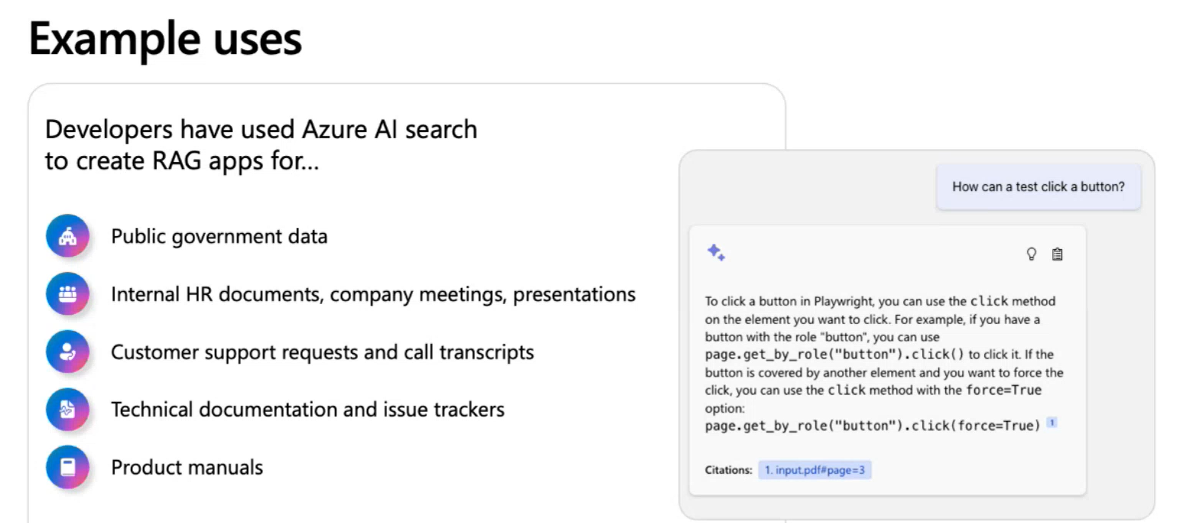
Notes:
Umm, so lot of information.
Uh, a lot of links as well, and but where we send this be really effective is and like public government data, which wasn't mined by GPT in the 1st place.
So here in Australia, like building standards, building codes and like a government policy, stuff like that is really, really effective at giving you relevant results and internal documents, company meetings, presentations, documentation about products.
Maybe there's internal like customer support request transcript, stuff like that.
Technical documentation.
This is excellent for.
So if a company has got like huge legacies of like PDF documents and they want to use an AI like this to give them a better capability to answer the questions or even like be one of the first responses in a particular issue tracker, you can use that and and product manuals as well.
It's really, really effective.
So the next steps I'd recommend is to learn a bit more about AI Search and look at the RAG relevance and evaluation tooling that we've got available.
The app that I showed you is available at that link, and that's the Python one.
There's another version of that in.net Java and JavaScript, and also if you want to check out AI Studio, you can see what you can do with RAG development as well.

Slide 60
Where next?
1
Learn more about Vector Databases
aka.ms/AzureAISearch
2
Dig more into quality evaluation details
aka.ms/ragrelevance
3
Deploy a RAG chat application for your organization’s data aka.ms/azai/python
4
Explore Azure AI Studio for a complete RAG development experience aka.ms/AzureAIStudio
Notes:
on um some additional resources that uh available to you that QR code goes to
the source code for this demo um so that is using Cosmos DB with a vector index
um I've got some um the images in there the products the descriptions the test
pictures all of that is open source so you feel free to copy it reuse it whatever you like um and the source code
for the uh the Azure function as well is in there but just kind of have a look at the prompt and what I've done with the
the prompt to kind of get a steer on how that works I recommend using the the playground as a way of kind of building
up how you want to do this type of capability uh um and then if you want to
learn more about Vector databases we've got some great resources to do that and we've also got more of like a chat
application which is a rag interaction uh which you can give like huge amounts of data like and PDFs and stuff like
that um and then if you want to use AI studio for more uh like rag development
as well then that's another capability to to use so yeah thank you very much for your time hopefully you've learned
something new today and you've seen how AI can be used for for not just chat applications um we can actually do a lot
more for an existing app and add a whole bunch of capabilities that you probably didn't even think uh were necessarily
possible or required like some deep knowledge with AI but it's really just typing uh prompts into a back end thank
you very much [Music]

Slide 61
Appendix

Slide 62
Incorporating domain knowledge
Prompt engineering
Fine tuning
Retrieval Augmented
Generation
In-context learning
Learn new skills
(permanently)
Learn new facts
(temporarily)

Slide 63
Agenda
Do you need an AI?
Introductions
Prerequisites for this tutorial
Demo application
AI is not just LLMs and GPT
Types of AI
Completions, embeddings and other LLM concepts
Multi-modal embeddings
Storing embeddings
Vector Search
Building AI applications in Python
(Hands on work)
Considerations for Production
Evaluations
Localizing indexes
Scaling and performance
Wrap Up
Notes:
Act 1: Do I need an AI?
Presentation
Introduction to the speakers
When and where can AI add value to your application? Do users want a chat-bot dialog in your website or can AI be used to enrich the experience?
Demo
Showing the application we're going to build
Act 2: AI is not just LLMs and GPT
Presentation
Types of AI
Chat completions, RAG and embeddings - breaking down AI technical terms
Text embeddings
Use cases for embedding models
Multi-modal embeddings- using embedding models for images, video and audio
Storing embeddings as vectors
Adding a vectorized embeddings to a NoSQL database with Cosmos DB
Searching vectors with similarity search
Hands-on exercises
We will use a Jupyter notebook to experiment with embeddings and doing similarity searches
Act 3: Building AI applications in Python
In this section we will take a basic FastAPI-powered application that has a web store and add functionality where a photographer adds pictures of products to a storage account. Using serverless triggers, these images are then converted into embeddings using an AI model and stored in a vector database. We will demonstrate how to then query that vector store to find similar pictures and match pictures with descriptions of existing products.
Hands-on exercises
The goal is to show a search feature in the website that users can type a query and it will locate the best product based on the name, description or picture. Users can then upload a picture of an outfit they like and it will find the best and most relevant product that is similar.
Setting up a storage container
Configuring a serverless function in Python to run whenever pictures are added to the storage container
Converting an image into an embedding
Setting up a vector database
Storing embeddings in a vector database
Creating search queries and similarity functions
Improving our search page
Adding a user-provided image upload to the site
Doing text-image and image-text relevance queries
Filtering data in queries
Act 4: Considerations for production
How do you assess how good your AI implementation is?
How do you measure new models and versions? Using relevance libraries
Localizing indexes and search - testing both English and Hindi. We will experiment with using Hindi queries on an English index
Thinking about scaling and performance
Writing tests for AI applications
Hands-on exercises
We will use a relevance model to measure and write test cases for our AI.
Act 5: Wrapping up
Where to go from here?
What about hybrid search?
Next steps and resources
Prerequisites:
We don't expect participants in this workshop to have any formal experience with AI. We will be breaking down concepts and talking about how AI converts text, video, images into a format (embedding) that can be used for predictive completion, search and comparisons. The application we will build in this workshop will be a serverless, cloud-based application. We will use Jupyter notebooks throughout for testing and exploration of concepts in AI. We will cover practical aspects of adding AI to applications, such as localization, testing, performance and scaling. Participants will be given credits to run and experiment with a deployed application in the cloud after the workshop. The technology shown in the workshop is Python, using open libraries and SDKs.

Slide 64
Using OpenAI LLMs: Python 🐍
response = openai.chat.completions.create(
messages = [
{
"role": "system",
"content": "You are a helpful assistant with very flowery language"
},
{
"role": "user",
"content": "what python frameworks does pamela use?"
}
])
for event in response:
print(event.choices[0].message.content)
🔗 https://github.com/pamelafox/python-openai-demos
Notes:
DEMO from python-openai-demos
DEMO of the quickstart example

